Slide 1

Revolutionising B.Tech

Slide 2


COMPUTER NETWORKS
Course Code: 22CSE103
MODULE - I
Dr Kranthi Ph.D., M. Tech (CSE), M. Tech (IT), MISTE, MCSI, MIAENG, MIFERP
Associate Professor, Department of CSE, FET
JAIN (Deemed-to-be University), Bangalore, India.
Email: kranthi.kumar@jainuniversity.ac.in
Phone: 7972677739
21 June 2023

Slide 3
Home
“In the beginning, there were no networks. Life was bad.” —MIKE MEYERS
Welcome to COMPUTER NETWORKS
The primary objective of this course is to impart a basic understanding of the working of computer networks, with the Internet as a case in point.

Slide 4
Table of Content
0. REAL-LIFE NETWORKS
BASIC OF COMPUTER NETWORKS
1.1 HARDWARE & SOFTWARE
Network Models and Protocols
2.1 OSI MODEL REFERENCE MODEL
2.2 TCP/IP REFERENCE MODEL
3. ARPANET, INTERNET
4. PHYSICAL LAYER
4.1 GUIDED TRANSMISSION MEDIA
4.1.1 TWISTED PAIRS, COAXIAL CABLE, FIBER OPTICS
4.2 WIRELESS TRANSMISSION

Slide 5

Aim
To equip students in the fundamentals and understanding of computer networks and their use in everyday communication and data exchange.

Slide 6

Explain the basics of networks to continue the further working on the network concepts
Differentiate various types of networks
Design different types of network architectures according to their requirements
Analyse the factor which helps in the right selection topology
Objective

Slide 7
0. Introduction to TEACHING REAL-LIFE NETWORKING
During the first part of this discussion, we will begin by relating networks to several already established situations and ideas.
It is helpful to be able to actually begin working with networks once you have gained an understanding of what networks are and what they are capable of doing.
In point of fact, because it is so beneficial to learn the ins and outs of networking through a hands-on guided practice, that is exactly what is going to be prepared for you here.
You are going to put yourself in the shoes of a worker at a made-up corporation, and you are going to have to learn on the job. The more you develop as a person, the more you will understand the function of computer networks as well as the necessity of their existence.

Slide 8
0. Introduction to TEACHING REAL-LIFE NETWORKING
0.1 Human Networks:
A network, in its most general meaning, is made up of two or more entities or objects that collaborate to share information and resources with one another.
Although we will be discussing computer networks in this session, there are other types of networks that do not require computers, and these other types of networks are widespread.
You have likely been accustomed to cooperating with them despite the fact that you are unaware of this fact.
You might not care about the fact that one of the key aspects of networking is sharing, which might mean either giving or receiving information. You are merely aware of your own actions.

Slide 9
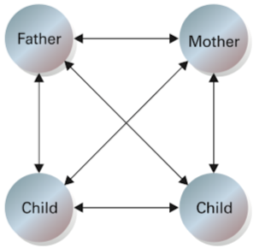
Real life Networks
0.1.1 Family Network :
The majority of people are part of a family network, which is a group of people that share their resources and information with one another.
This sharing is a two-way street because even the youngest members of the family participate in some form of information exchange. The network expands in tandem with the size of the family.
A network connects members of a family together

Slide 10
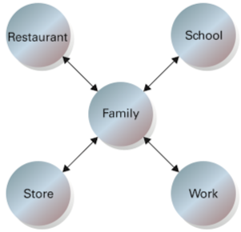
Real life Networks
0.1.2 Peer Network : A community exists apart from a family that provides access to a greater variety of resources than the average family is able to provide for its members. It is only logical to integrate the family into this community in order to make full use of the abundant resources that are spread throughout the municipality.
This type of knowledge or resource sharing can be as basic as lending a hammer to a neighbor, car-pooling with work associates, or assisting a friend with his or her schoolwork. Other examples include car-pooling with work associates.
Sharing or exchanging resources is an integral part of each of these activities. This type of network is characterized by relationships that go in both directions, with equals or peers engaging in exchanges of information.
The family network connects with the greater community.

Slide 11
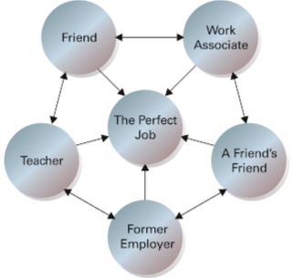
Real life Networks
0.1.3 Contact Network :
Networking is a great approach to locate a job. Create a list of friends and associates who can help you find the perfect job. More contacts increase your job prospects.
As you advance in your career, your function in your contact network will alter, making it most useful. You may soon help those that helped you. Your personal and professional networks expand opportunities.
These human networks demonstrate that networking is not limited to computers. This course will focus on computer networks—connecting and communicating computers.
The more people in your network,
the better your chances of finding that perfect job.

Slide 12
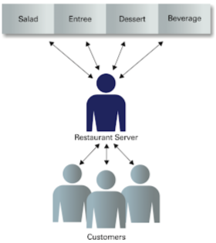
Real life Networks
0.1.4 Restaurant Network:
The Client/Server Thus, human networks involve giving and taking. You're more familiar with networking's client/server perspective than you think.
You're a customer at a restaurant when you eat and drink there. However, the waiter controls and delivers meals to customers.
The server knows that orders will be placed and that he will serve them (access is provided when the order is delivered).
In a dining situation, it is easy to know whether
you are supposed to be serving or being served.

Slide 13
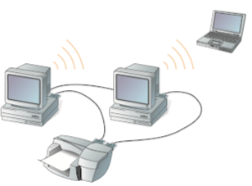
1. BASICS OF Computer Networks
As shown in Figure, a computer network consists of two or more computing devices that are interconnected in order to share the network's components (its resources) and the information stored there.
A network is a collection of autonomous computers connected via a singular technology to facilitate data communication.
When additional computers join and contribute their resources to those being shared, even the simplest computer network (consisting of only two connected computers) can grow and become more useful.
A computer network can be as simple as
two or more computers communicating.

Slide 14
1. BASICS OF Computer Networks: Network Plan
When attempting to identify which computer communicates with and shares resources with which other computers, it can rapidly become difficult and unmanageable to network computers first and then track the connections. For example,
Do you share everything in your human network with your friends?
Would you want your parents or authorities to know your every thought in your family network?
You have a plan for sharing information in your head, and it is essential to keep track of it so you don't accidentally share something in an unintended location.
Similar considerations must be taken into account when designing a computer network. Before connecting your first devices, you should have a strategy.
Therefore, a network plan is a formal document that depicts all the network's components and their intended connections. A similar plan is also utilized to manage the various types of data. Your plan should indicate which categories of data are stored where and who is authorized to access each type.

Slide 15
1. BASICS OF Computer Networks : Information Management
Your network strategy should help you manage the information collected, stored, and shared among users.
If you were given a vacant three-drawer filing cabinet and told to organize your company's information, you would have a manual filing system that requires a plan. Having an overall guide that specifies who will have access to each of the three compartments will help you decide what to store in each one.
Once you have this portion of the plan, you could place the least-used information in the bottom drawer, the most-used information in the middle drawer, and the least-used information in the top drawer to make it simpler for your users to access the information.
Knowing who needs to know what and its inverse, who does not need to know what, allows you to decide whether or not to secure a specific drawer.
Even when discussing the implementation of a manual three-drawer filing system, the significance of having a network plan in place becomes apparent. If you place restricted materials in a receptacle accessible to all employees, how do you ensure their security? Later, additional security measures (such as adding a lock to a compartment or relocating the sensitive information) may be necessary.

Slide 16
1. BASICS OF Computer Networks : Information Management (Cont.)
As specific types of sensitive data (such as medical, personal, or payroll information) are gathered or combined, they should be stored higher in the hierarchical structure (from most sensitive to least sensitive), which can ultimately save you time. This plan should specify that the access requirements for sensitive data are more stringent and limit the number of individuals who can use specific categories of information.
The distribution aspect of the networking strategy, as opposed to the accumulation aspect discussed above, should stipulate that the more access an individual has to data in storage, the less they should be able to share groups of entrusted information.
For instance, you may not mind sharing your first name, but you would likely object to an instructor sharing all of your school records with anyone who requests them.

Slide 17
1. BASICS OF Computer Networks: Information’s Importance (Cont.)
Similar to sustaining a manual filing system, information management on networks is essential for the collection, manipulation, and effective tracking of numerous seemingly unimportant pieces of information.
A solitary piece of data in a data field, such as your first name, may appear insignificant. By combining your first name with other pieces of related information, such as your last name, address, age, gender, and phone number (stored in other data fields), it is possible to create a data record that accurately describes something (or someone) significant, such as you.
Lastly, combining similar records (such as those characterizing your classmates) creates a file that is more sensitive than a single record because it contains sensitive information from multiple sources.
Therefore, information sharing raises significant security concerns, and network access to data must be carefully evaluated so that only those who require it have access.

Slide 18
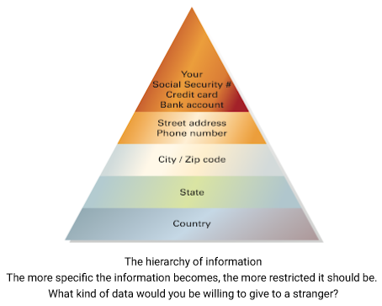
1. BASICS OF Computer Networks: Information’s Importance
Few individuals within the organization have access to this information. For instance, credit card and Social Security numbers are examples of information that requires the utmost level of security; only a small number of employees have access to this information.
On the other hand, some information, such as Web pages, newsletters, and product information, is made available to the public, including those outside of an organization.
The diagram illustrates how this information is organized into a hierarchy, with the most specific and secure information located at the top and the more general and less secure information at the bottom.
How much personal information would you be willing to share with a total stranger? Origin of birth? Sure. State of domicile? Why then? However, you should consider twice before giving a stranger your street address or phone number.

Slide 19
1. BASICS OF Computer Networks: Network Performance Criteria
The most important criteria to get an effective and efficient network are
1. Performance
2. Reliability
3. Security
1. Performance: It depends upon
Number of users: As the number of users increases, the network's efficacy degrades.
Transmission medium: Medium defines the maximum data transmission pace.
Hardware: Hardware can affect both transmission speed and capacity. A faster computer with more storage provides superior performance.
Software: Well-defined software can accelerate the process and improve transmission efficiency.

Slide 20
1. BASICS OF Computer Networks: Network Performance Criteria: (Cont.)
2. Reliability: Frequency of failures, time to recover from failure, and network resilience to calamitous events are used to measure reliability.
A network that recovers rapidly is more valuable.
A network must be safeguarded against catastrophic occurrences such as earthquakes, fires, and larceny.
3. Security: Network security comprises the protection of data against unauthorized access and malware.
Unauthorized access: Sensitive data must be protected from unauthorized access and active intrusion for a network to be useful. If not, data loss may result. Two levels of protection must be implemented to prevent data loss.
On a lower level, user identification codes and passwords are employed, whereas on a higher level, encryption techniques are utilized. Encryption is the process of transforming plaintext into ciphertext using a key. At the receiving end, the encrypted text is converted back to plain text.
A computer infection is an unwelcome anomaly that disrupts computer operation. A network is vulnerable to infections because it is accessible from multiple points.

Slide 21
1. BASICS OF Computer Networks: Computer Communications
Computer communications describes a process in which two or more computers or devices transfer data, instructions, and information. Some communications involve cables and wires; others are sent wirelessly through the air. communications systems contain all types of computers and computing devices.
For successful communications, you need the following:
A sending device that initiates an instruction to transmit data, instructions, or information.
A communications device that connects the sending device to a communications channel.
A communications channel, or transmission media on which the data, instructions, or information travel.
A communications device that connects the communications channel to a receiving device.
A receiving device that accepts the transmission of data, instructions, or information.

Slide 22
1. BASICS OF Computer Networks: Effectiveness of a Data Communications
The effectiveness of a data communications system depends on four fundamental characteristics:
Delivery: The system must deliver data to the correct destination. Data must be received by the intended device or user and only by that device or user.
Accuracy: The system must deliver the data accurately. Data that have been altered in transmission and left uncorrected are unusable.
Timeliness: The system must deliver data promptly. Data delivered late are useless. In the case of video and audio, timely delivery means delivering data as they are produced, in the same order that they are produced, and without significant delay. This kind of delivery is called real-time transmission.
Jitter: Jitter refers to the variation in the packet arrival time. It is the uneven delay in the delivery of audio or video packets. For example, let us assume that video packets are sent every 3ms. If some of the packets arrive with 3ms delay and others with 4ms delay, an uneven quality in the video results.

Slide 23
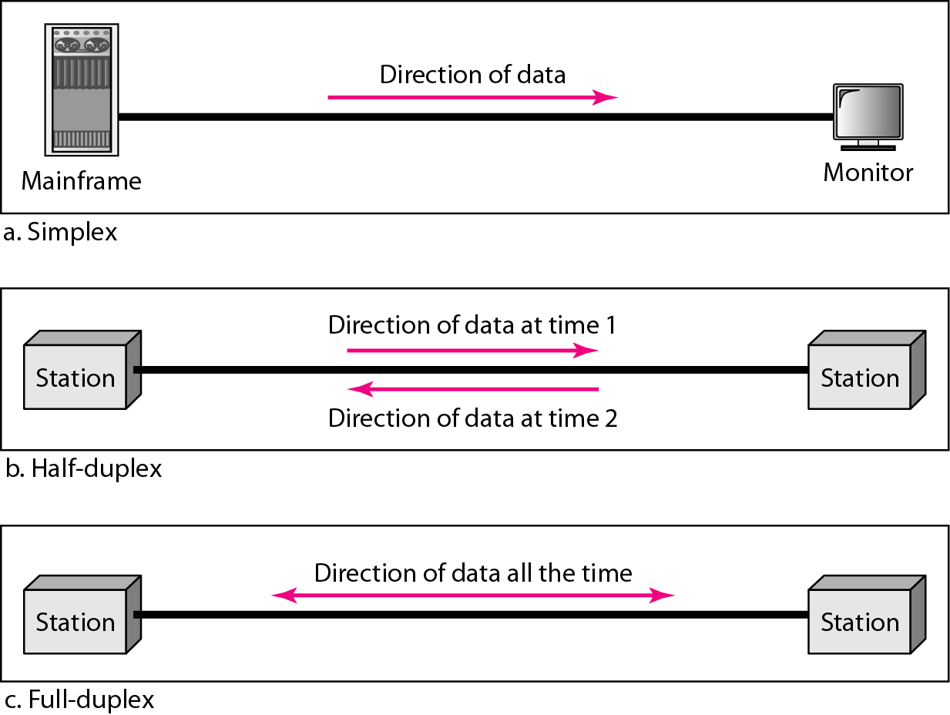
1. BASICS OF Computer Networks:
Communication Modes: Communication between two devices can be
Simplex
Half-Duplex
Full-Duplex
Simplex: In simplex mode, the communication is unidirectional, as on a one-way street. Only one of the two devices on a link can transmit; the other can only receive. The simplex mode can use the entire capacity of the channel to send data in one direction.
Figure: Simplex Communication
Ex: Keyboards and traditional monitors.
The keyboard can only introduce input; the monitor can only accept output.

Slide 24
1. BASICS OF Computer Networks:
Half Duplex:
In half-duplex mode, each station can both transmit and receive, but not at the same time. When one device is sending, the other can only receive, and vice versa.
The half-duplex mode is like a one-lane road with traffic allowed in both directions when cars are travelling in one direction, cars going the other way must wait.
In a half-duplex transmission, the entire capacity of a channel is taken over by whichever of the two devices is transmitting at the time.
The half-duplex mode is used in cases where there is no need for communication in both directions at the same time; the entire capacity of the channel can be utilized for each direction.
Figure: Half-Duplex Communication
Ex: Walkie-talkies and CB (citizens band) radios are both half-duplex systems.

Slide 25
1. BASICS OF Computer Networks:
Full Duplex:
In full-duplex mode, both stations can transmit and receive simultaneously
The full-duplex mode is like a two-way street with traffic flowing in both directions at the same time.
In full-duplex mode, signals going in one direction share the capacity of the link: with signals going in the other direction.
This sharing can occur in two ways: Either the link must contain two physically separate transmission paths, one for sending and the other for receiving; or the capacity of the channel is divided between signals travelling in both directions.
The full-duplex mode is used when communication in both directions is required all the time. The capacity of the channel, must be divided between the two directions.
Figure: Full Duplex Communication
Ex: telephone network, when two people are communicating by a telephone line, both can talk and listen at the same time.

Slide 26
1. BASICS OF Computer Networks:
Line Configuration: A network is two or more devices connected through links. A link is a communications pathway that transfers data from one device to another. For communication to occur, two devices must be connected in some way to the same link at the same time. There are two possible types of connections: Point-To-Point and Broadcast (Multipoint).
Point-to-Point Links: A point-to-point connection provides a dedicated link between two devices.
The entire capacity of the link is reserved for transmission between those two devices.
Most point-to-point connections use an actual length of wire or cable to connect the two ends, but other options, such as microwave or satellite links, are also possible.
When you change television channels by infrared remote control, you are establishing a point-to-point connection between the remote control and the television's control system.
Point-to-Point links can be in between a node-to-node, a node and mainframe.
Broadcast Links: A Broadcast (multipoint, multidrop) connection is one in which more than two specific devices share a single link.
In a multipoint environment, the capacity of the channel is shared, either spatially or temporally.
If several devices can use the link simultaneously, it is a spatially shared connection.
If users must take turns, it is a timeshare connection.

Slide 27
1. BASICS OF Computer Networks: Network Devices
Repeater – A repeater operates at the physical layer. Its job is to regenerate the signal over the same network before the signal becomes too weak or corrupted so as to extend the length to which the signal can be transmitted over the same network. An important point to be noted about repeaters is that they do not amplify the signal. When the signal becomes weak, they copy the signal bit by bit and regenerate it at the original strength. It is a 2 port device.
Hub – A hub is basically a multiport repeater. A hub connects multiple wires coming from different branches, for example, the connector in star topology which connects different stations. Hubs cannot filter data, so data packets are sent to all connected devices. In other words, collision domain of all hosts connected through Hub remains one. Also, they do not have intelligence to find out best path for data packets which leads to inefficiencies and wastage.
Bridge – A bridge operates at data link layer. A bridge is a repeater, with add on the functionality of filtering content by reading the MAC addresses of source and destination. It is also used for interconnecting two LANs working on the same protocol. It has a single input and single output port, thus making it a 2 port device.
Switch – A switch is a multiport bridge with a buffer and a design that can boost its efficiency(many ports imply less traffic) and performance. A switch is a data link layer device. The switch can perform error checking before forwarding data, which makes it very efficient as it does not forward packets that have errors and forward good packets selectively to the correct port only. In other words, the switch divides the collision domain of hosts, but the broadcast domain remains the same.

Slide 28
1. BASICS OF Computer Networks: 1.1 HARDWARE & SOFTWARE
Router – A router is a device like a switch that routes data packets based on their IP addresses. A Router is mainly a Network Layer device. Routers normally connect LANs and WANs together and have a dynamically updating routing table based on which they make decisions on routing the data packets. The router divides the broadcast domains of hosts connected through it.
Gateway – A gateway, as the name suggests, is a passage to connect two networks together that may work upon different networking models. They work as messenger agents that take data from one system, interpret it, and transfer it to another. Gateways are also called protocol converters and can operate at any network layer. Gateways are generally more complex than switches or routers.
Brouter – It is also known as the bridging router, a device that combines features of both bridge and router. It can work either at the data link layer or the network layer. Working as a router, it is capable of routing packets across networks and, working as bridge e, it can filter local area network traffic.

Slide 29
1. BASICS OF Computer Networks: 1.1 HARDWARE & SOFTWARE
Network Hardware: The importance of network hardware in establishing and sustaining various types of networks is introduced. It includes a vast array of devices and technologies that facilitate communication and data transfer within and between networks. This presentation will provide a comprehensive comprehension of network hardware in relation to various network types.
Personal Local Area Networks (PANs): Personal Area Networks (PANs) are networks that connect devices within an individual's personal space, typically encompassing a small area such as a room or office. PANs enable communication between personal devices such as smartphones, tablets, laptops, wearables, and other Internet of Things (IoT) devices.
Typical PAN Devices PANs consist of a variety of wireless-capable devices. Smartphones, tablets, laptops, wearable devices (such as smartwatches and fitness monitors), and smart home devices (such as voice assistants and smart thermostats) are included in this category. These devices can establish PANs using Bluetooth and Zigbee technologies.
Bluetooth is the most prevalent wireless technology for PANs. It enables short-range communication between devices (up to 100 meters), permitting data transfer and connectivity. Zigbee is another wireless technology that enables low-power, low-data-rate communication for PANs and is commonly used in Internet of Things devices.
PANs have applicability in a variety of domains. PANs are essential to home automation, where devices such as smart lighting, thermostats, and security systems are connected via a home network. PANs also contribute to personal entertainment systems by facilitating the wireless transmission of audio and video between devices.

Slide 30
1. BASICS OF Computer Networks: 1.1 HARDWARE & SOFTWARE
Local Area Networks (LANs) are the second category.
Description and Qualities: LANs are networks that connect devices within a limited geographical location, such as a building, campus, or office. LANs provide high-speed data transmission and facilitate device-to-device resource sharing. LANs can be structured using a variety of topologies, including bus, star, ring, and mesh. The star topology connects devices to a central node or switch, whereas the bus topology connects devices to a common communication medium. The ring topology creates a circular connection, whereas the mesh topology offers multiple interconnected paths for fault tolerance and redundancy.
LAN Components: LANs comprise several essential components. Network Interface Cards (NICs) connect devices to a network. Switches and hubs connect devices centrally, facilitating data transmission. In wired LANs, Ethernet cables and connectors such as RJ-45 are used to establish tangible connections.
Ethernet and Wi-Fi Standards: Ethernet is the most popular LAN technology currently available. It defines data transmission standards over wired networks. Ethernet standards include Ethernet, Fast Ethernet, Gigabit Ethernet, and 10 Gigabit Ethernet, with varying data transfer rates. Wi-Fi standards (802.11a/b/g/n/ac/ax, for example) enable wireless connectivity in LANs.
LAN Technologies: Ethernet, Token Ring, and FDDI: The evolution of Ethernet technology has resulted in increased velocities and capabilities. It provides a LAN solution that is dependable, scalable, and extensively supported. Token Ring is an antiquated LAN technology that controls data transmission using a token-passing mechanism. Fiber Distributed Data Interface (FDDI) is a high-speed LAN technology that transmits data quickly and reliably over fiber optic cables.

Slide 31
1. BASICS OF Computer Networks: 1.1 HARDWARE & SOFTWARE
MANs -- Metropolitan Area Networks: MANs encompass a greater geographical area than LANs, typically a city or metropolitan area. MANs connect multiple LANs and offer connectivity to numerous organizations and institutions in a city.
MANs comprise backbone and distribution nodes. As central points of connectivity, backbone nodes contain network equipment such as routers and switches. Distribution nodes connect LANs to a network's backbone. MANs utilize fiber optic cables and repeaters to ensure efficient data transmission.
Fiber Optic Networks: Due to its high bandwidth, low latency, and long-distance capabilities, MANs significantly rely on fiber optic technology. Optical fiber cables use light signals to transmit data, allowing for quick and reliable communication. Wavelength Division Multiplexing (WDM) is a technique utilized in MANs to simultaneously transmit multiple signals over a single fiber.
MAN Technologies: SONET, SDH, and MPLS: Synchronous Optical Networking (SONET) and Synchronous Digital Hierarchy (SDH) are extensively used in MANs. They offer standard methods for data transmission and multiplexing over fiber optic networks. MPLS is another technology utilized in MANs for packet forwarding and traffic management.
Implementation Examples of MANs MANs play a crucial role in establishing citywide connectivity. They provide high-speed Internet access, interconnect various organizations, and facilitate communication between universities, hospitals, and government offices. MANs are also the foundation of smart city initiatives.

Slide 32
1. BASICS OF Computer Networks: 1.1 HARDWARE & SOFTWARE
WANs are Wide Area Networks: Wide Area Networks (WANs) link geographically dispersed networks, such as those spanning countries or continents. WANs permit organizations to establish a unified network infrastructure by facilitating communication between multiple locations. WAN Connectivity Options: Wide-area networks (WANs) offer a variety of connectivity options to connect dispersed networks. Leased lines, including T1/E1 and T3/E3, offer point-to-point connections. For WAN connectivity, Digital Subscriber Line (DSL) and cable modem utilize the existing telephone and cable infrastructure. Satellite and microwave connections provide long-distance wireless connectivity.
Wide Area Network (WAN) Components: Routers, Switches, and Modems: In WANs, routers play a crucial role in facilitating the routing of data between networks. Multiple devices within a WAN are connected via switches, enabling efficient data transfer. To establish WAN connections, modems are utilized to convert digital signals to analog signals for transmission over telephone lines or cable networks.
Leased Lines, Frame Relay, ATM, and MPLS: WAN Technologies: WANs utilize a variety of technologies to facilitate data transfer and connectivity. Leased lines offer dedicated, dependable connections with bandwidth guarantees. Utilized in WANs, Frame Relay is a packet-switching technology that provides efficient utilization of network resources. Asynchronous Transfer Mode (ATM) is a WAN-appropriate cell-based switching technology. In WAN environments, MPLS provides enhanced routing and traffic management capabilities.
Virtual Private Networks (VPNs) and Cloud-based WAN Solutions: By establishing encrypted tunnels, Virtual Private Networks (VPNs) enable secure communication over public networks. VPNs are widely used in WANs to assure the privacy and integrity of data. Software-Defined WAN (SD-WAN) and other cloud-based WAN solutions leverage cloud services and virtualization to facilitate WAN management and enhance network performance.

Slide 33
1. BASICS OF Computer Networks: 1.1 HARDWARE & SOFTWARE
Networks and the Internet: Internetworking is the process of connecting multiple networks to create a larger, interconnected network. It entails the utilization of routers to facilitate data transit between networks.
Internet Protocol (IP) Fundamentals IP is a fundamental internetworking protocol. It provides addressing and routing capabilities, enabling the transmission of data packets across interconnected networks. IP addresses (IPv4 and IPv6) are used to uniquely identify network devices.
Routing protocols, such as OSPF (Open Shortest Path First) and EIGRP (Enhanced Interior Gateway Routing Protocol), are utilized to determine the optimal path for data packets across internetworks. Virtual Local Area Networks (VLANs) and switching technologies, such as VLAN Trunking Protocol (VTP), allow for efficient data transmission within internetworks.
Network Address Translation (NAT) is a method for translating private IP addresses into public IP addresses. NAT enables multiple devices on a private network to share a single public IP address, thereby enhancing network security and enabling internet access.
Routers are essential for connecting LANs and WANs. They facilitate inter-network data transmission by analyzing IP addresses and making routing decisions. Gateway devices, such as firewalls and VPN concentrators, are used to secure the connection between LANs and WANs.

Slide 34
1. BASICS OF Computer Networks: 1.1 HARDWARE & SOFTWARE
Network Software: Software for networks plays a crucial function in facilitating network communication and data transfer. It includes protocols, service primitives, and design considerations for the efficient operation of a network. This presentation will provide a comprehensive comprehension of network software, including protocol hierarchies, layer design issues, connection-oriented versus connectionless services, service primitives, and the relationship between protocols and services.
Protocol Hierarchies: Protocol hierarchies refer to the layering of network protocols, with each layer being responsible for specific duties. Protocol hierarchies enable modular and efficient design by enabling seamless interaction between layers. Network protocols are typically organized in a stratified architecture, such as the OSI (Open Systems Interconnection) or TCP/IP (Transmission Control Protocol/Internet Protocol) models. These models define multiple strata, each with distinct responsibilities and functions. Each layer of a protocol hierarchy conducts specific tasks and provides services to the layer above it. To facilitate end-to-end communication, protocols within each layer communicate with their corresponding layers on remote systems.
Design Considerations for the Layers: Designing interfaces between layers requires delineating the services, protocols, and data formats that each layer should provide and expect. In network software, well-defined interfaces facilitate interoperability and modularity. Encapsulation involves encapsulating data from higher layers in protocol headers at lower layers. Adding necessary information, such as source and destination addresses, enables the transmission of data through the network.

Slide 35
1. BASICS OF Computer Networks: 1.1 HARDWARE & SOFTWARE
Addressing and Routing: Addressing refers to the designation of devices within a network. Routing refers to the transmission of data between devices. Routing entails identifying the most efficient path for data packets to reach their destination. Designing effective addressing and routing mechanisms is essential for network functionality.
Error Detection and Correction: The design of error detection and correction mechanisms assures the integrity of data transmission across networks. Error detection techniques, such as checksums, verify the integrity of data, whereas error correction techniques, such as retransmission or error-correcting codes, assist in the recovery of corrupted data.
Connection-based as opposed to connectionless service: Connection-Based Support: Before data transmission, connection-oriented services establish a dedicated, reliable communication path between sender and receiver. This method ensures delivery and transmission of requested data, but incurs additional expenses. Connectionless services do not necessitate the establishment of a dedicated path in advance. Data packets are transmitted independently, and each packet contains sufficient routing and delivery information (e.g., the destination address) for delivery. Connectionless service offers simplicity and efficiency, but data transmission may be disordered or unreliable.
Service Fundamentals: The operations or functions that network software provides to applications or higher-level protocols are known as service primitives. They define the means by which applications can gain access to network services. Service primitives can be divided into three categories: request, indication, and response. Request primitives initiate a particular action, indication primitives inform the application of an event or received data, and response primitives acknowledge the action's completion or status.
Relationship between Protocols and Services: Services Offered by Protocols:Within a network, protocols define the norms and procedures for data transmission and communication. Such services as data encapsulation, error detection, routing, and flow control are provided to higher-level protocols and applications.
Mapping of Services to Protocols: Various protocols may offer various services or variants of the same service. Selecting appropriate protocols for each layer to accomplish the desired functionality and network behavior is required when mapping services to protocols.

Slide 36
Network Topologies
Types of Network Topology
The arrangement of a network which comprises of nodes and connecting lines via sender and receiver is referred as network topology. The various network topologies are :
Mesh topology
Star topology
Bus topology
Ring topology
Tree topology
Hybrid topology

Slide 37
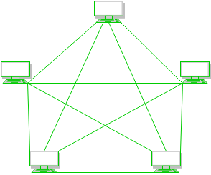
Network Topologies
a) Mesh Topology :
In mesh topology, every device is connected to another device via a channel.

Slide 38
Network Topologies
Figure 1 : Every device relates to another via dedicated channels. These channels are known as links.
If suppose, N number of devices relate to each other in mesh topology, then total number of ports that is required by each device is ? N-1. In the Figure 1, there are 5 devices connected to each other, hence total number of ports required is 4.
If suppose, N number of devices relate to each other in mesh topology, then total number of dedicated links required to connect them is ^{N}C₂ i.e. N(N-1)/2. In the Figure 1, there are 5 devices connected to each other, hence total number of links required is 5*4/2 = 10.

Slide 39
Network Topologies
Advantages of Mesh topology :
It is robust.
Fault is diagnosed easily. Data is reliable because data is transferred among the devices through dedicated channels or links.
Provides security and privacy.
Problems with this topology :
Installation and configuration is difficult.
Cost of cables are high as bulk wiring is required, hence suitable for a smaller number of devices.
Cost of maintenance is high.

Slide 40
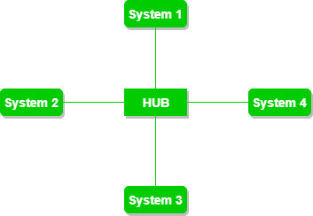
Network Topologies
b) Star Topology :
In star topology, all the devices are connected to a single hub through a cable.

Slide 41
Network Topologies
Figure 2 : A star topology having four systems connected to single point of connection i.e. hub. Advantages of this topology :
If N devices are connected to each other in star topology, then the number of cables required to connect them is N. So, it is easy to set up.
Each device require only 1 port i.e. to connect to the hub.
Problems with this topology :
If the concentrator (hub) on which the whole topology relies fails, the whole system will crash down.
Cost of installation is high.
Performance is based on the single concentrator i.e. hub.

Slide 42
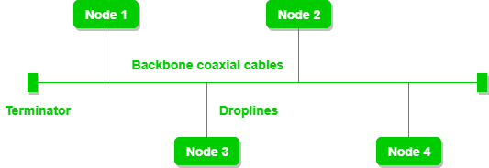
Network Topologies
c) Bus Topology :
Bus topology is a network type in which every computer and network device is connected to single cable. It transmits the data from one end to another in single direction. No bi-directional feature is in bus topology.

Slide 43
Network Topologies
Figure 3 : A bus topology with shared backbone cable. The nodes are connected to the channel via drop lines.
Advantages of this topology :
If N devices are connected to each other in bus topology, then the number of cables required to connect them is 1 ?which is known as backbone cable and N drop lines are required.
Cost of the cable is less as compared to other topology, but it is used to build small networks.
Problems with this topology :
If the common cable fails, then the whole system will crash down.
If the network traffic is heavy, it increases collisions in the network. To avoid this, various protocols are used in MAC layer known as Pure Aloha, Slotted Aloha, CSMA/CD etc.

Slide 44
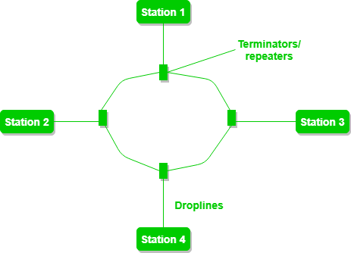
Network Topologies
d) Ring Topology :
In this topology, it forms a ring connecting a devices with its exactly two neighbouring devices.

Slide 45
Network Topologies
Figure 4 : A ring topology comprises of 4 stations connected with each forming a ring.. The following operations takes place in ring topology are :
One station is known as monitor station which takes all the responsibility to perform the operations.
To transmit the data, station must hold the token. After the transmission is done, the token is to be released for other stations to use.
When no station is transmitting the data, then the token will circulate in the ring.
There are two types of token release techniques : Early token release releases the token just after the transmitting the data and Delay token release releases the token after the acknowledgement is received from the receiver.

Slide 46
Network Topologies
Advantages of this topology :
The possibility of collision is minimum in this type of topology.
Cheap to install and expand.
Problems with this topology :
Troubleshooting is difficult in this topology.
Addition of stations in between or removal of stations can disturb the whole topology.

Slide 47
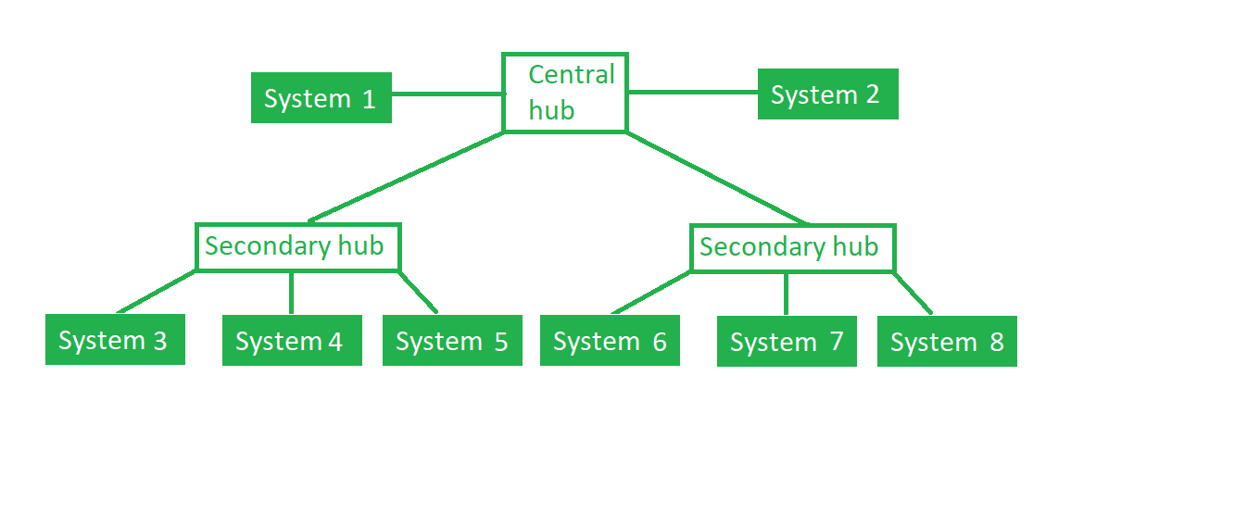
Network Topologies
e) Tree Topology :
This topology is the variation of Star topology. This topology have hierarchical flow of data.

Slide 48
Network Topologies
Figure 5 : In this the various secondary hubs are connected to the central hub which contains the repeater. In this data flow from top to bottom i.e from the central hub to secondary and then to the devices or from bottom to top i.e. devices to secondary hub and then to the central hub.
Advantages of this topology :
It allows more devices to be attached to a single central hub thus it increases the distance that is travel by the signal to come to the devices.
It allows the network to get isolate and prioritize from different computers.
Problems with this topology :
If the central hub gets fails, the entire system fails.
The cost is high because of cabling.

Slide 49
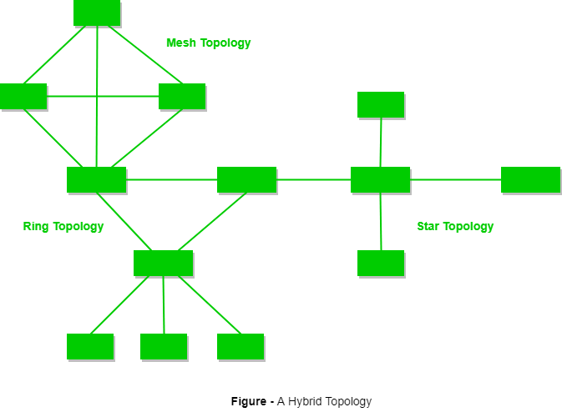
Network Topologies
f) Hybrid Topology : This topology is a collection of two or more topologies which are described above. This is a scalable topology which can be expanded easily. It is reliable one but at the same it is a costly topology.
Figure 6 : A hybrid topology which is a combination of ring and star topology.

Slide 50
Assessments
Here are some assessments you can use to evaluate your understanding of the fundamentals of computer networks:
Multiple Choice Questions:
Create a set of multiple-choice questions covering various aspects of network hardware, software, topologies, LANs, MANs, WANs, the Internet, network devices, communication modes, and point-to-point/multipoint links. Provide options and ask learners to select the correct answer.
Example question: Which network device operates at the Data Link layer of the OSI model? a) Router b) Hub c) Switch d) Modem
Network Design Scenario:
Provide a hypothetical network scenario and ask learners to design an appropriate network for it. Include details such as the number of users, required bandwidth, security considerations, and geographical layout. Assess their ability to choose the right hardware, software, and network topology for the given scenario.
Example scenario: Design a network for a small company with two offices located in different cities. The offices need to communicate securely and share files. The network should also allow for future scalability.
Network Troubleshooting:
Present a network diagram with several issues (e.g., connectivity problems, misconfigurations, hardware failures). Ask learners to identify and troubleshoot the issues. Evaluate their understanding of network devices, protocols, and troubleshooting techniques.
Example task: Analyze the given network diagram and explain the possible reasons why two computers in different LANs are unable to communicate with each other.
Network Terminology Matching:
Provide a list of network-related terms and a corresponding list of definitions or descriptions. Ask learners to match each term with its correct definition.
Example terms: a) DHCP b) OSI model c) Router d) Mesh topology
Example definitions:
A network protocol that assigns IP addresses dynamically to devices on a network.
A network device that operates at the Network layer of the OSI model and connects different networks.
A networking standard that divides network communications into seven layers.
A network topology where every device is connected to every other device.
Case Study Analysis:
Present a real-world case study related to computer networks, such as a network security breach or a network upgrade project. Ask learners to analyze the case study, identify the key issues, and propose solutions based on their knowledge of network fundamentals.
Example case study: A company's network experienced a security breach where sensitive customer data was stolen. Analyze the situation and suggest measures to prevent future breaches and enhance network security.
These assessments can help you evaluate learners' comprehension of network hardware, software, topologies, LANs, MANs, WANs, the Internet, network devices, communication modes, and point-to-point/multipoint links. Adjust the difficulty level and scope of the assessments according to the learners' proficiency and learning objectives.

Slide 51
Activities
Here are some activities that can help you understand the fundamentals of computer networks:
Network Hardware Exploration:
Identify and list different types of network hardware such as routers, switches, modems, network interface cards (NICs), and cables.
Research and compare specifications and features of different network hardware devices.
Create a presentation or poster showcasing the functions and uses of various network hardware components.
Network Software Analysis:
Investigate different network protocols such as TCP/IP, UDP, HTTP, FTP, and DNS.
Install network monitoring software like Wireshark and analyze network traffic.
Conduct a simulation or create a network diagram using software like Cisco Packet Tracer.
Network Topology Design:
Research different network topologies, including bus, star, ring, mesh, and hybrid topologies.
Design a network topology for a small office or home network, considering factors like scalability, cost, and performance.
Discuss the advantages and disadvantages of each topology and justify your design choice.
LAN, MAN, and WAN Comparison:
Differentiate between Local Area Networks (LANs), Metropolitan Area Networks (MANs), and Wide Area Networks (WANs).
Research examples of each type of network and identify their typical uses and characteristics.
Create a chart or infographic highlighting the differences and similarities between LANs, MANs, and WANs.
Internet Research and Analysis:
Study the history and evolution of the Internet, including its infrastructure, protocols, and services.
Investigate the role of Internet Service Providers (ISPs) and how they connect users to the Internet.
Examine the impact of the Internet on various aspects of society, such as communication, commerce, and education.
Network Device Exploration:
Identify and categorize different network devices like routers, switches, firewalls, access points, and network-attached storage (NAS) devices.
Research the functionalities and configurations of each device and how they contribute to network management and security.
Set up a small network using these devices and configure their settings for optimal performance.
Communication Modes Experimentation:
Explore different communication modes, such as simplex, half-duplex, and full-duplex.
Set up a simple communication system using two computers and test each mode of communication.
Discuss the advantages and disadvantages of each mode and their real-world applications.
Point-to-Point and Multipoint Links:
Differentiate between point-to-point and multipoint links in networking.
Create a scenario where point-to-point links are used, such as connecting two remote offices.
Design a multipoint network, like a wireless network for a small campus, and discuss the challenges and benefits.
These activities should provide you with a hands-on understanding of the fundamentals of computer networks, including network hardware, software, topologies, LANs, MANs, WANs, the Internet, network devices, communication modes, and point-to-point/multipoint links.

Slide 52
Did You Know?
Did you know? The World Wide Web (WWW) and the Internet are not the same things. The Internet is a global network infrastructure that connects millions of devices worldwide, while the World Wide Web refers to the collection of interconnected websites accessible via the Internet.
True statement: LAN stands for Local Area Network and is used to connect devices within a limited geographic area such as a home, office, or school. It typically utilizes Ethernet cables or Wi-Fi for connectivity.
Did you know? A firewall is a network security device that monitors and controls incoming and outgoing network traffic based on predetermined security rules. It acts as a barrier between a trusted internal network and an untrusted external network, such as the Internet.
True statement: MAN stands for Metropolitan Area Network and covers a larger geographical area than a LAN, typically spanning a city or town. It interconnects multiple LANs and may be operated by a single organization or a service provider.
Did you know? Wi-Fi, a popular wireless technology, uses radio waves to transmit data over short distances. It is based on the IEEE 802.11 standards and allows devices to connect to a network without the need for physical cables.
True statement: WAN stands for Wide Area Network and covers a wide geographic area, often spanning multiple cities or countries. It is used to connect multiple LANs and MANs, and examples include the Internet and private leased lines.
Did you know? The OSI (Open Systems Interconnection) model is a conceptual framework that standardizes the functions of a network into seven layers. These layers include Physical, Data Link, Network, Transport, Session, Presentation, and Application layers.
True statement: Routers are network devices that operate at the Network layer of the OSI model. They direct data packets between different networks by examining destination IP addresses and choosing the best path for data transmission.
Did you know? Bluetooth is a wireless communication technology used for short-range data transmission between devices. It is commonly used for connecting peripherals like keyboards, mice, and headphones to computers or mobile devices.
True statement: Point-to-Point links connect two devices directly, enabling communication between them. On the other hand, multipoint links allow multiple devices to communicate with each other simultaneously.
These facts and statements provide interesting insights into the fundamentals of computer networks, covering topics such as network hardware, software, topologies, LANs, MANs, WANs, the Internet, network devices, communication modes, point-to-point, and multipoint links.

Slide 53
2. Network Models and Protocols:
In this section, we will discuss the network models and the related protocols in detail to understand “how the data is transferred and received at a computer level.”
We mainly focus on two important network models, which are
The OSI reference model
The TCP/IP reference model
Although the protocols associated with the OSI model are rarely used anymore, the model itself is quite general and still valid, and the features discussed at each layer are still very important.
The TCP/IP model has the opposite properties: the model itself is not of much use, but the protocols are widely used. For this reason, we will look at both of them in detail. Also, sometimes you can learn more from failures than from successes.

Slide 54
2. Network Models and Protocols:
Before we discuss the computer network models, let’s have a discussion on the layers that a computer model consists. Let’s have a basic idea of the layers involved in data communication.
Layers of a Computer Network models
The main purpose of having several layers in a computer network model is to divide the process of sending and receiving data into small tasks.
These layers are connected with each other, each layer provides certain data to its immediate higher and immediate lower layer and receives certain data from the same.
Dividing a model is layers makes the structure quite simple which makes it easy to identify the issue if it occurs.

Slide 55
2. Network Models and Protocols:
There are three main components of a computer network model. Sender, receiver and carrier.
On the sender side:
Higher layer: Higher layer serves the middle layer and directs the message (or data) to the middle layer. Middle layer: Middle layer picks up the data from the higher layer and transfers it to the lower layer. Lower layer: The data is transmitted to the lower layer of the receiver side.
On the receiver side:
Lower layer: Receives the data from the lower layer of the sender side and transfers it to the middle layer. Middle layer: Middle layer picks up the data from the lower layer and transfers to the higher layer. Higher layer: Higher layer transfers the data to the receiver.
We will discuss more than one computer model here, each model has a different set and design of layers.

Slide 56
2. Network Models and Protocols: 2.1 OSI MODEL REFERENCE MODEL
we will discuss the OSI model in computer networks and the seven layers of the OSI model in detail.
1. OSI Model stands for Open System interconnection model. OSI Model defines how data is transferred from one computer to another computer.
2. In a basic scenario, two computers connected with a LAN transfer the data. This forms a computer network, however, if both the system uses different operating systems, for example, one system runs on Windows, and the other one runs on Mac OS, then how can data be transferred between these two different systems, here comes the role of an OSI model which is a seven-layered model that defines how a data can be transferred between different systems.
3. International Organisation introduced the OSI model for Standardization (ISO) in 1984.
4. There are seven layers in an OSI model
7. Application layer
6. Presentation Layer
5. Session layer
4. Transport layer
3. Network Layer
2. Data Link layer
1. Physical layer

Slide 57
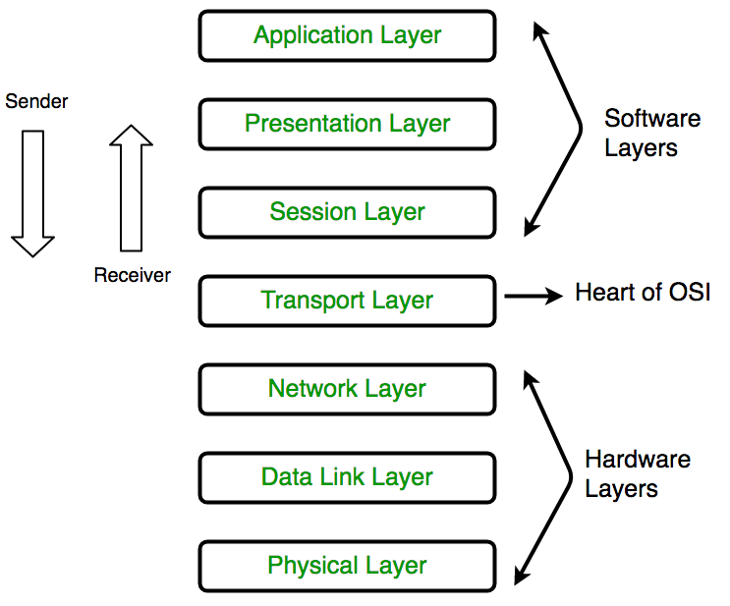
2.1 ISO – OSI NEWORK MODEL
What are protocols in computer network model?
A network protocol is an established set of rules that determine how data is transmitted between different devices in the same network. Essentially, it allows connected devices to communicate with each other, regardless of any differences in their internal processes, structure or design.
What are interfaces in computer network model?
the mechanism for communication between adjacent layers in the model is called an interface. ... For example, the layer 2/3 interface is used by a layer two and layer three protocol to pass data and control information; the layer 3/4 interface connects layers 3 and 4 together.

Slide 58
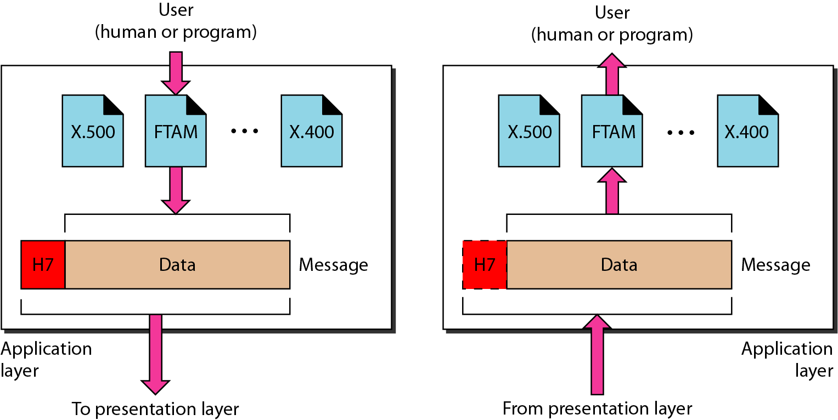
2.1 ISO – OSI NETWORK MODEL
7. Application Layer (Layer 7) : At the very top of the OSI Reference Model stack of layers, we find Application layer which is implemented by the network applications. These applications produce the data, which has to be transferred over the network. This layer also serves as a window for the application services to access the network and for displaying the received information to the user. Ex: Application–Browsers, Skype Messenger etc. Application Layer is also called as Desktop Layer.
It provides user interfaces and support for services such as electronic mail, remote file access and transfer, shared database management, and other types of distributed information services.
Figure shows the relationship of the application layer to the user and the presentation layer. Of the many application services available, the figure shows only three: X.400 (message-handling services), X.500 (directory services), and file transfer, access, and management (FTAM).
Figure: Application Layer

Slide 59
2.1 ISO – OSI NETWORK MODEL
7. Application Layer (Layer 7) : Specific services provided by the application layer include the following:
Network virtual terminal: A network virtual terminal is a software version of a physical terminal, and it allows a user to log on to a remote host. To do so, the application creates a software emulation of a terminal at the remote host. The user's computer talks to the software terminal which, in turn, talks to the host, and vice versa. The remote host believes it is communicating with one of its own terminals and allows the user to log on.
File transfer, access, and management: This application allows a user to access files in a remote host (to make changes or read data), to retrieve files from a remote computer for use in the local computer, and to manage or control files in a remote computer locally.
Mail services: This application provides the basis for e-mail forwarding and storage.
Directory services: This application provides distributed database sources and access for global information about various objects and services.
OSI model acts as a reference model and is not implemented in the Internet because of its late invention. The current model being used is the TCP/IP model.

Slide 60
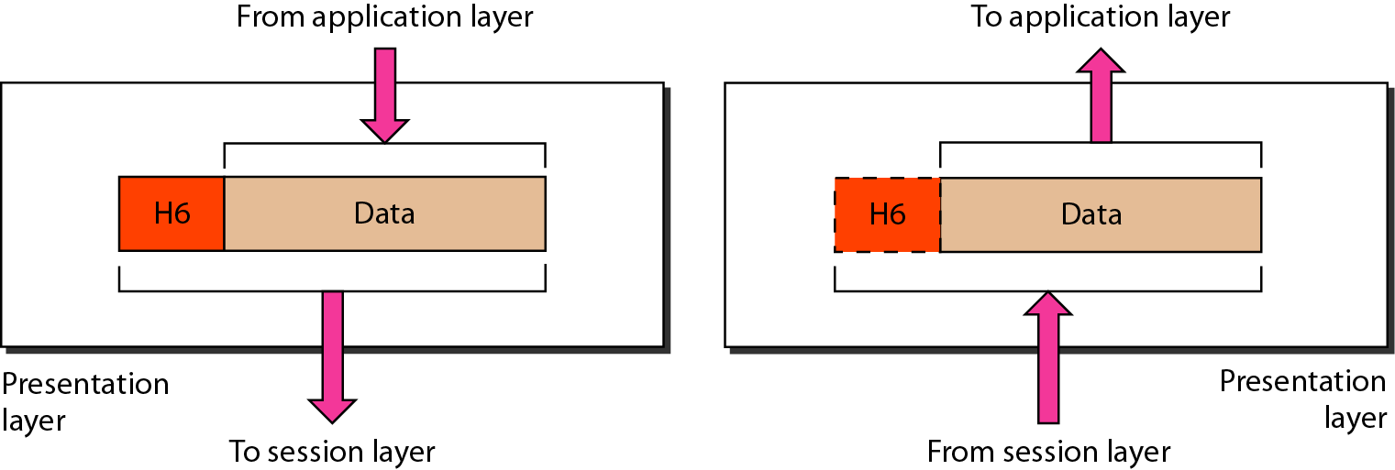
2.1 ISO – OSI NETWORK MODEL
6. Presentation Layer (Layer 6) : The presentation layer is concerned with the syntax and semantics of the information exchanged between two systems. The presentation layer is responsible for translation, compression, and encryption. Figure shows the relationship between the presentation layer and the application and session layers.
Figure: Presentation layer

Slide 61
2.1 ISO – OSI NETWORK MODEL
Specific responsibilities of the presentation layer include the following:
Translation: The processes (running programs) in two systems are usually exchanging information in the form of character strings, numbers, and so on. The information must be changed to bit streams before being transmitted. Because different computers use different encoding systems, the presentation layer is responsible for interoperability between these different encoding methods. The presentation layer at the sender changes the information from its sender-dependent format into a common format. The presentation layer at the receiving machine changes the common format into its receiver-dependent format. For example, ASCII to EBCDIC.
Encryption: To carry sensitive information, a system must be able to ensure privacy. Encryption means that the sender transforms the original information to another form and sends the resulting message out over the network. Decryption reverses the original process to transform the message back to its original form.
Compression: Data compression reduces the number of bits contained in the information. Data compression becomes particularly important in the transmission of multimedia such as text, audio, and video.

Slide 62
2.1 ISO – OSI NETWORK MODEL
5. Session Layer (Layer 5) : This layer is responsible for establishment of connection, maintenance of sessions, authentication and also ensures security. The services provided by the first three layers (physical, data link, and network) are not sufficient for some processes.
Specific responsibilities of the session layer include the following:
Session establishment, maintenance and termination: The session layer is the network dialog controller . The layer allows the two processes to establish, use and terminate a connection
Dialog control: The session layer allows two systems to enter into a dialog. It allows the communication between two processes to take place in either half-duplex (one way at a time) or full-duplex (two ways at a time) mode.
Synchronization: The session layer allows a process to add checkpoints, or synchronization points, to a stream of data. For example, if a system is sending a file of 2000 pages, it is advisable to insert checkpoints after every 100 pages to ensure that each 100-page unit is received and acknowledged independently. In this case, if a crash happens during the transmission of page 523, the only pages that need to be resent after system recovery are pages 501 to 523. Pages previous to 501 need not be resent.

Slide 63
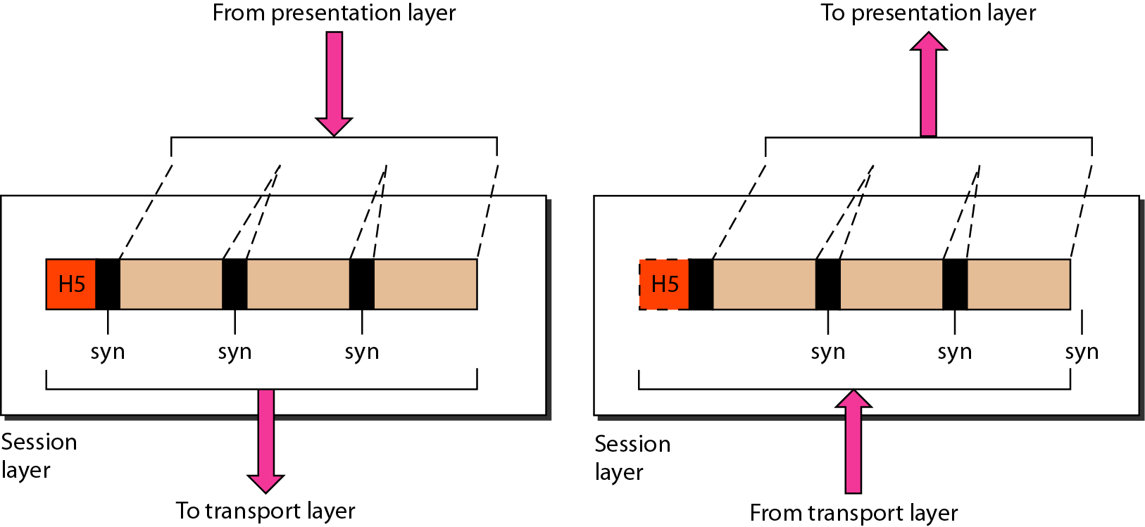
2.1 ISO – OSI NETWORK MODEL
5. Session Layer (Layer 5) :
Figure illustrates the relationship of the session layer to the transport and presentation layers.
Figure: Session layer

Slide 64
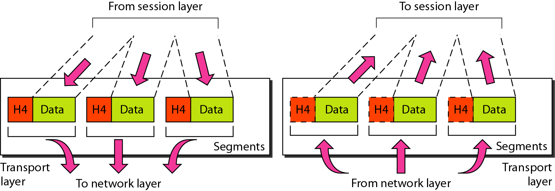
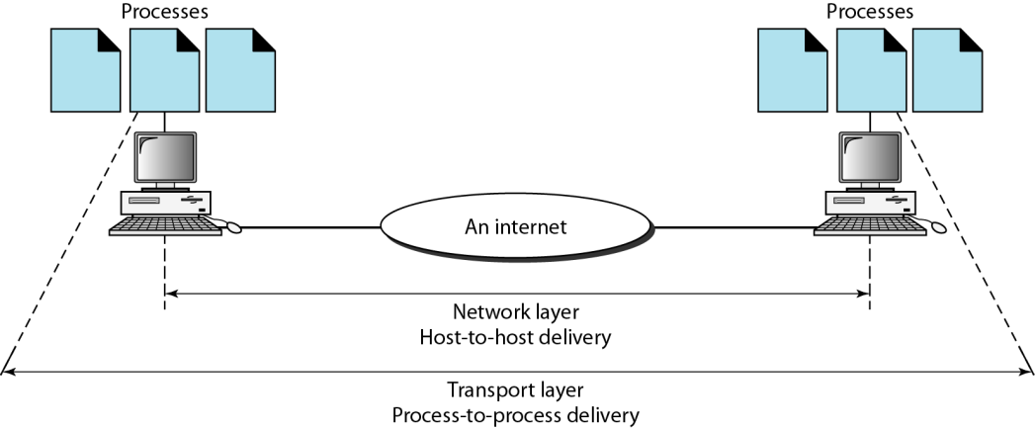
2.1 ISO – OSI NETWORK MODEL
4. Transport Layer (Layer 4) : The transport layer is responsible for process-to-process delivery of the entire message. The transport layer is responsible for the delivery of a message from one process to another. A process is an application program running on a host. Whereas the network layer oversees source-to-destination delivery of individual packets, it does not recognize any relationship between those packets. It treats each one independently, as though each piece belonged to a separate message, whether or not it does. The transport layer, on the other hand, ensures that the whole message arrives intact and in order, overseeing both error control and flow control at the source-to-destination level.
Figure: Transport Layer Figure: Process-to-Process Delivery

Slide 65
2.1 ISO – OSI NETWORK MODEL
4. Transport Layer (Layer 4) : Other responsibilities of the transport layer include the following:
Service-point addressing: Computers often run several programs at the same time. For this reason, source-to-destination delivery means delivery not only from one computer to the next but also from a specific process on one computer to a specific process on the other. The transport layer header must therefore include a type of address called a service-point address (or port address). The network layer gets each packet to the correct computer; the transport layer gets the entire message to the correct process on that computer.
Segmentation and reassembly: A message is divided into transmittable segments, with each segment containing a sequence number. These numbers enable the transport layer to reassemble the message correctly upon arriving at the destination and to identify and replace packets that were lost in transmission.
Connection control: The transport layer can be either connectionless or connection-oriented. A connectionless transport layer treats each segment as an independent packet and delivers it to the transport layer at the destination machine. A connection-oriented transport layer makes a connection with the transport layer at the destination machine first before delivering the packets. After all the data are transferred, the connection is terminated.
Flow control: Like the data link layer, the transport layer is responsible for flow control. However, flow control at this layer is performed end to end rather than across a single link.
Error control: Like the data link layer, the transport layer is responsible for error control. However, error control at this layer is performed process-to-process rather than across a single link. The sending transport layer makes sure that the entire message arrives at the receiving transport layer without error (damage, loss, or duplication). Error correction is usually achieved through retransmission.

Slide 66
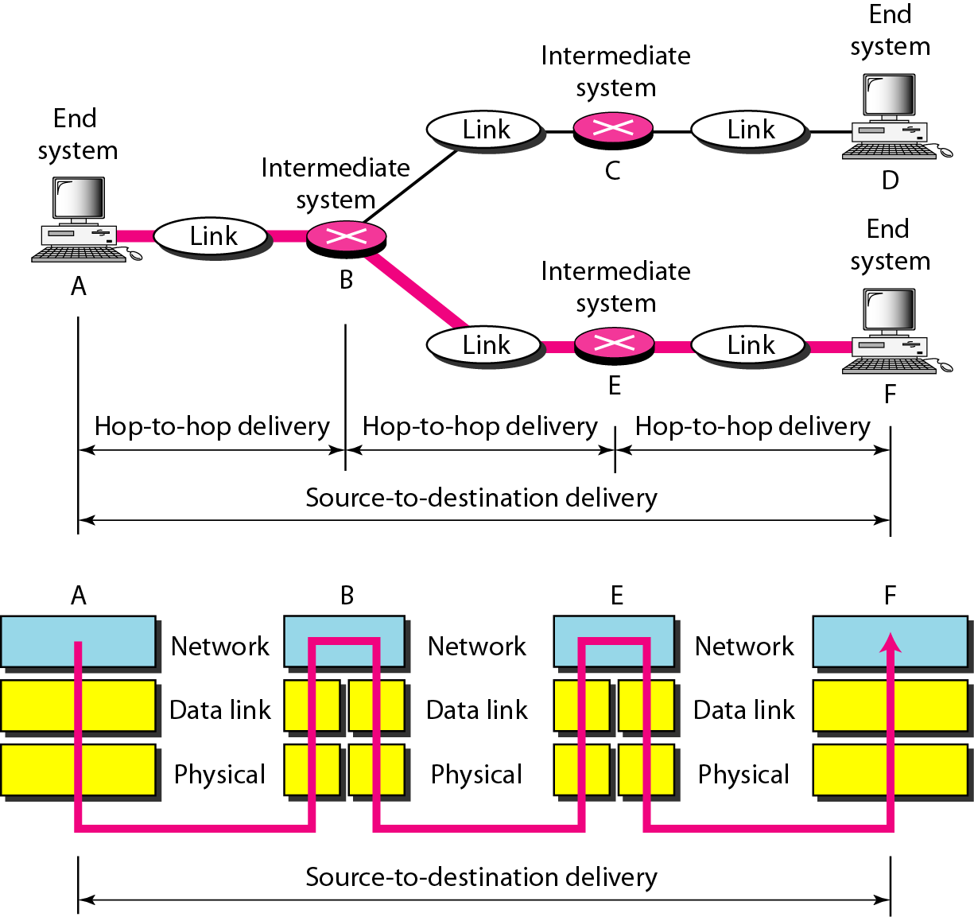
2.1 ISO – OSI NETWORK MODEL
3. Network Layer (Layer 3) : The network layer is responsible for The Source-To-Destination Delivery of a packet, possibly across multiple networks (links). Whereas the data link layer oversees the delivery of the packet between two systems on the same network (links). N.L also takes care of packet routing i.e. selection of the shortest path to transmit the packet, from the number of routes available. The sender & receiver’s IP address are placed in the header by the network layer.
Figure: Source-to-Destination Delivery

Slide 67
2.1 ISO – OSI NETWORK MODEL
3. Network Layer (Layer 3) :
Other responsibilities of the network layer include the following:
Logical addressing: The physical addressing implemented by the data link layer handles the addressing problem locally. If a packet passes the network boundary, we need another addressing system to help distinguish the source and destination systems. The network layer adds a header to the packet coming from the upper layer that, among other things, includes the logical addresses of the sender and receiver.
Routing: When independent networks or links are connected to create internetworks (network of networks) or a large network, the connecting devices (called routers or switches) route or switch the packets to their final destination. The network layer protocols determine which route is suitable from source to destination. This function of network layer is known as routing.

Slide 68
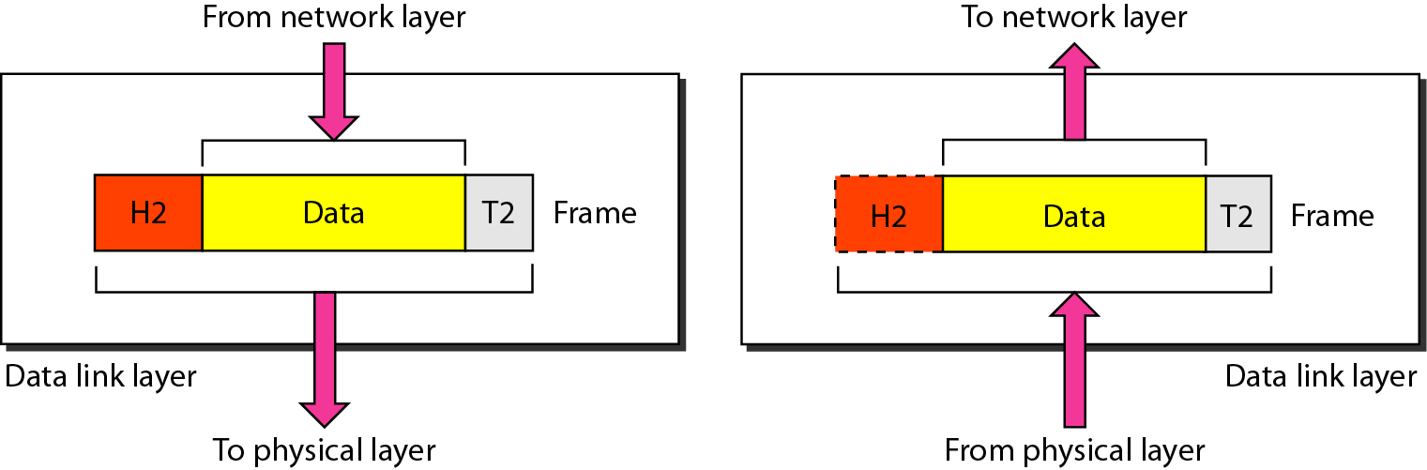
2.1 ISO – OSI NETWORK MODEL
2. Data Link Layer (DLL) (Layer 2) : The data link layer transforms the physical layer, a raw transmission facility, to a reliable link. It makes the physical layer appear error-free to the upper layer (network layer). Data Link Layer is divided into two sub layers : Logical Link Control (LLC) and Media Access Control (MAC)
Figure: Data Link Layer

Slide 69
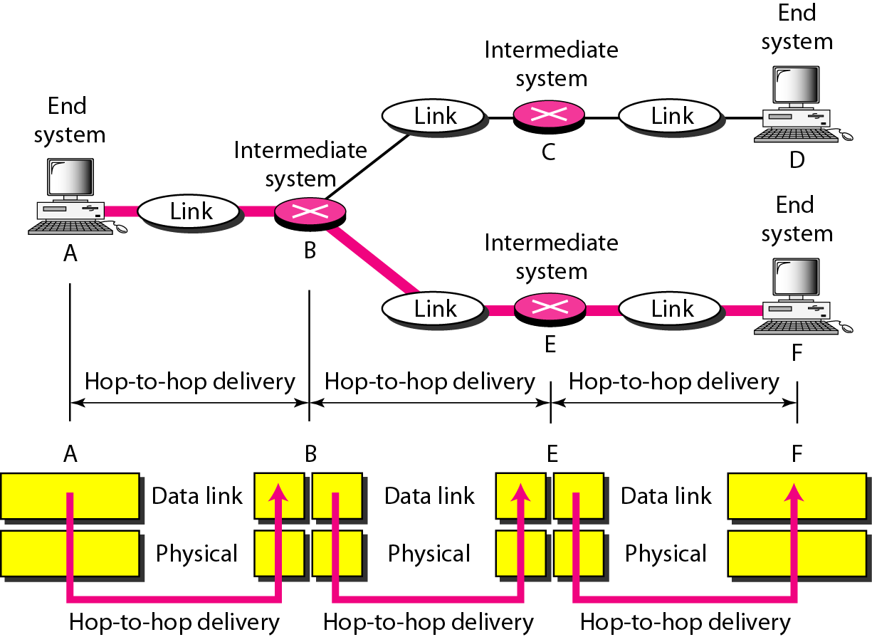
2.1 ISO – OSI NETWORK MODEL
2. Data Link Layer (DLL) (Layer 2) :The data link layer is responsible for moving frames from one hop (node) to the next. This is called “Hop-To-Hop Delivery" or "Node-to-Node Delivery". Packet in Data Link layer is referred as Frame. Data Link layer is handled by the NIC (Network Interface Card) and device drivers of host machines. Switch & Bridge are Data Link Layer devices.
Figure: Hop-to-Hop Delivery

Slide 70
2.1 ISO – OSI NETWORK MODEL
2. Data Link Layer (DLL) (Layer 2) : Other responsibilities of the data link layer include the following:
Framing: The data link layer divides the stream of bits received from the network layer into manageable data units called frames.
Physical addressing: If frames are to be distributed to different systems on the network, the data link layer adds a header to the frame to define the sender and/or receiver of the frame(using MAC address). If the frame is intended for a system outside the sender's network, the receiver address is the address of the device that connects the network to the next one.
Flow control: If the rate at which the data are absorbed by the receiver is less than the rate at which data are produced in the sender, the data link layer imposes a flow control mechanism to avoid overwhelming the receiver.
Error control: The data link layer adds reliability to the physical layer by adding mechanisms to detect and retransmit damaged or lost frames. It also uses a mechanism to recognize duplicate frames. Error control is normally achieved through a trailer added to the end of the frame.
Access control: When two or more devices are connected to the same link, data link layer protocols are necessary to determine which device has control over the link at any given time.(using LLC)

Slide 71
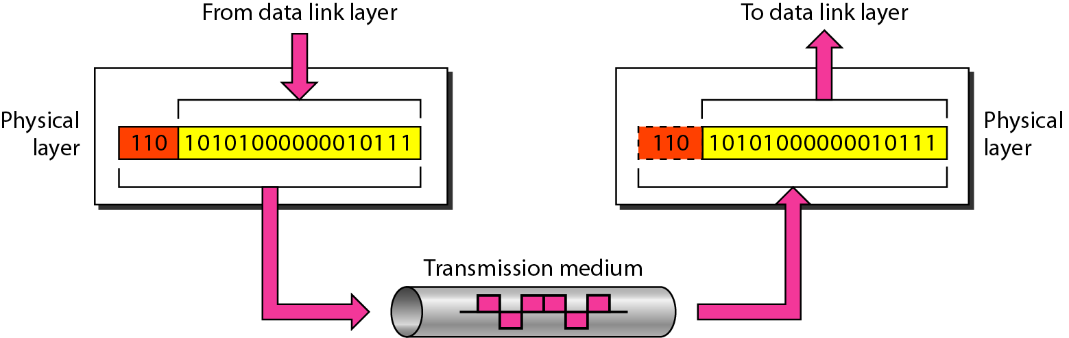
2.1 ISO – OSI NETWORK MODEL
Physical Layer (Layer 1) :
The lowest layer of the OSI reference model is the physical layer. It is responsible for the actual physical connection between the devices. The physical layer contains information in the form of bits. It is responsible for transmitting individual bits from one node to the next. When receiving data, this layer will get the signal received and convert it into 0s and 1s and send them to the Data Link layer, which will put the frame back together.
Figure: Physical Layer

Slide 72
2.1 ISO – OSI NETWORK MODEL
1. Physical Layer (Layer 1) : The functions of the physical layer are :
Physical characteristics of interfaces and medium: The physical layer defines the characteristics of the interface between the devices and the transmission medium. It also defines the type of transmission medium.
Representation of bits: The physical layer data consists of a stream of bits (sequence of 0’s or 1’s) with no interpretation. To be transmitted, bits must be encoded into signals--electrical or optical. The physical layer defines the type of encoding (how 0’s and 1’s are changed to signals).
Data rate or Transmission rate: The number of bits sent each second is also defined by the physical layer. In other words, the physical layer defines the duration of a bit, which is how long it lasts.
Synchronization of bits: The sender and receiver not only must use the same bit rate but also must be synchronized at the bit level. In other words, the sender and the receiver clocks must be synchronized.
Line configuration: The physical layer is concerned with the connection of devices to the media. In a point-to-point configuration, two devices are connected through a dedicated link. In a multipoint configuration, a link is shared among several devices.
Physical topology: The physical topology defines how devices are connected to make a network. Devices can be connected by using a mesh topology (every device is connected to every other device), a star topology (devices are connected through a central device), a ring topology (each device is connected to the next, forming a ring), a bus topology (every device is on a common link), or a hybrid topology (this is a combination of two or more topologies) Transmission mode: The physical layer also defines the direction of transmission between two devices: simplex, half-duplex, or full-duplex. In simplex mode, only one device can send; the other can only receive. The simplex mode is a one-way communication. In the half-duplex mode, two devices can send and receive, but not at the same time. In a full-duplex (or simply duplex) mode, two devices can send and receive at the same time.

Slide 73
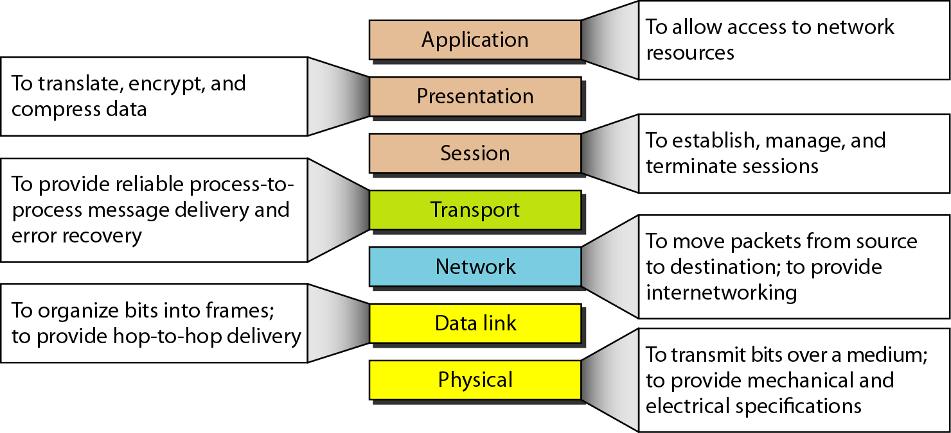
2.1 ISO – OSI NETWORK MODEL
Figure: Summary of Layers

Slide 74
2.2 TCP/IP NETWORK MODEL
The OSI Model that we have just examined is merely a reference/logical model. It was created to define the functions of the communication system by breaking down the communication process into smaller, more manageable components.
In the 1960s, the Department of Defense (DoD) designed and developed TCP/IP, which is founded on standard protocols. Internet Protocol stands for Transmission Control Protocol. TCP/IP is an abbreviated version of the OSI model. Unlike the OSI model, which has seven layers, it has only four.
Five or four layers are sometimes cited as the number of strata. Here This article will examine five strata. In the 4-layer reference, the Physical Layer and Data Link Layer are referred to as a single layer known as the 'Physical Layer' or 'Network Interface Layer’.
What is TCP/IP Used For?
TCP/IP's primary function is to transmit computer data from one device to another. The primary requirement of this procedure is that data be reliable and accurate, so that the recipient receives the same information as the submitter. To ensure that each message reaches its final destination accurately, the TCP/IP model divides its data into packets, which are then recombined at the receiving end, thereby preserving the integrity of the data during transmission.

Slide 75
2.2 TCP/IP NETWORK MODEL
What Difference Exists Between TCP and IP?
TCP and IP are distinct Computer Network protocols. The transmission of data is the primary distinction between TCP (Transmission Control Protocol) and IP (Internet Protocol). IP determines the mail's destination, while TCP is responsible for sending and receiving mail. UDP is an alternative protocol that does not require IP to communicate between computers. IP is only required by TCP. This is the fundamental distinction between TCP and IP.
How Does TCP/IP Model Operate?
When we want to send something over the internet using the TCP/IP Model, the data is divided into packets at the sender's end and recombined at the receiver's end to maintain the data's integrity. The TCP/IP paradigm divides the data into a four-layer procedure, with the data entering the first layer in one direction and then reentering in the opposite direction at the receiver's end.

Slide 76
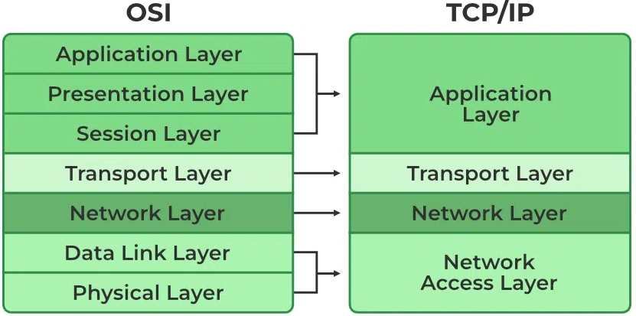
2.2 TCP/IP NETWORK MODEL
TCP/IP Model Layers
Application Layer
Transport Layer(TCP/UDP)
Network/Internet Layer(IP)
Data Link Layer (MAC)
Physical Layer
Following is a diagrammatic comparison of the TCP/IP and OSI models:

Slide 77
2.2 TCP/IP NETWORK MODEL
1. Physical Layer: It is a group of applications requiring network communications. This layer is responsible for generating the data and requesting connections. It acts on behalf of the sender and the Network Access layer on the behalf of the receiver. During this article, we will be talking on the behalf of the receiver.
2. Data Link Layer: The packet’s network protocol type, in this case, TCP/IP, is identified by the data-link layer. Error prevention and “framing” are also provided by the data-link layer. Point-to-Point Protocol (PPP) framing and Ethernet IEEE 802.2 framing are two examples of data-link layer protocols.
3. Internet Layer: This layer parallels the functions of OSI’s Network layer. It defines the protocols which are responsible for the logical transmission of data over the entire network. The main protocols residing at this layer are as follows:
IP: IP stands for Internet Protocol and it is responsible for delivering packets from the source host to the destination host by looking at the IP addresses in the packet headers. IP has 2 versions: IPv4 and IPv6. IPv4 is the one that most websites are using currently. But IPv6 is growing as the number of IPv4 addresses is limited in number when compared to the number of users.
ICMP: ICMP stands for Internet Control Message Protocol. It is encapsulated within IP datagrams and is responsible for providing hosts with information about network problems.
ARP: ARP stands for Address Resolution Protocol. Its job is to find the hardware address of a host from a known IP address. ARP has several types: Reverse ARP, Proxy ARP, Gratuitous ARP, and Inverse ARP.
The Internet Layer is a layer in the Internet Protocol (IP) suite, which is the set of protocols that define the Internet. The Internet Layer is responsible for routing packets of data from one device to another across a network. It does this by assigning each device a unique IP address, which is used to identify the device and determine the route that packets should take to reach it.

Slide 78
2.2 TCP/IP NETWORK MODEL
Imagine that you are sending an email to a friend using a computer. When you select "send," the email is divided into smaller data packets, which are then routed by the Internet Layer. The Internet Layer assigns an IP address to each packet and employs routing tables to determine the packet's optimal route to its destination. The packet is then transmitted to the subsequent hop until it reaches its final destination. Once all of the packets have been delivered, your friend's computer will be able to reconstruct the original email message.
The Internet Layer plays a crucial role in transmitting the email from your computer to your friend's computer in this example. It utilizes IP addresses and routing tables to determine the optimal path for the transmissions and ensures that they reach their intended destination. Without the Internet Layer, Internet data transmission would be impossible.
4. Transport Layer
The TCP/IP transport layer protocols exchange data receipt acknowledgements and retransmit lost packets to ensure packets arrive without error and in the correct order. Communication from end to end is referred to as such. User Datagram Protocol (UDP) and Transmission Control Protocol (TCP) are transport layer protocols at this level.
Using TCP, applications can communicate with one another as if they were tangibly connected by a circuit. TCP transmits data in a manner resembling character-by-character transmission as opposed to packet-by-packet transmission. This transmission consists of a beginning point that establishes the connection, the entire transmission in byte order, and an ending point that closes the connection.
UPD: UPD, the other transport layer protocol, provides the datagram delivery service. UDP does not verify connections between receiving and transmitting hosts. UDP is preferable to TCP for applications that transport small quantities of data because it eliminates the processes of establishing and validating connections.

Slide 79
2.2 TCP/IP NETWORK MODEL
5. Application Layer: This layer corresponds to the transport layer in the OSI model. It is in charge of end-to-end communication and error-free data delivery. It shields higher-level applications from the data's complexity. The three most important protocols in this stratum are:
HTTP and HTTPS refer to the Hypertext transfer protocol (HTTP). It is used to manage communications between web browsers and servers on the World Wide Web. HTTPS is an acronym for HTTP Secure. It is HTTP combined with SSL (Secure Socket Layer). It is effective when the browser must complete out forms, sign in, authenticate themselves, and conduct bank transactions.
SSH is an acronym for Secure Shell. It is software that emulates terminals analogous to Telnet. Because of its capacity to maintain a secure connection, SSH is the preferred protocol. It establishes a secure TCP/IP connection session.
Network Time Protocol, or NTP, is the abbreviation for Network Time Protocol. It is used to synchronize our computer's timers with a standard time source. It is extremely beneficial in situations such as banking transactions. Consider the following scenario in the absence of NTP. Consider a transaction in which your computer displays the time as 2:30 p.m. while the server records it as 2:28 p.m. When the server is out of sync, it can fail severely.

Slide 80
2.2 TCP/IP NETWORK MODEL
In the OSI architecture, the host-to-host layer is responsible for facilitating communication between hosts (computers or other devices) on a network. Transport layer is another name for this stratum. Typical applications of the host-to-host layer include:
Using techniques such as error correction and flow control, the host-to-host layer guarantees the reliability of data transfer between hosts. For instance, if a data packet is lost during transmission, the host-to-host layer can request retransmission to ensure that all data is received accurately.
Segmentation and Reassembly: The host-to-host layer is responsible for separating large data packets into smaller segments that can be transmitted over the network and then reassembling the data at the destination. This enables for more efficient data transmission and helps prevent network congestion.
The host-to-host layer is responsible for multiplexing data from multiple sources onto a single network connection and demultiplexing the data at the destination. This enables multiple devices to share a single network connection, thereby increasing network utilization.
End-to-End Communication: The host-to-host layer provides a connection-oriented service that enables hosts to communicate end-to-end without intermediate devices.
Consider a network containing two hosts, A and B. A host wishes to transmit a file to another host. The host-to-host layer on host A will divide the file into smaller segments, add error correction and flow control data, and then send the segments to host B over the network. Host B's host-to-host layer will receive the segments, verify for errors, and reassemble the file. Once the file has been effectively transferred, the host-to-host layer in host B will confirm receipt to host A. In this example, the host-to-host layer is responsible for establishing a secure connection between hosts A and B, segmenting the file, and reassembling the segments at the destination. In addition to multiplexing and demultiplexing the data, it is also responsible for supplying end-to-end communication between the two hosts.

Slide 81
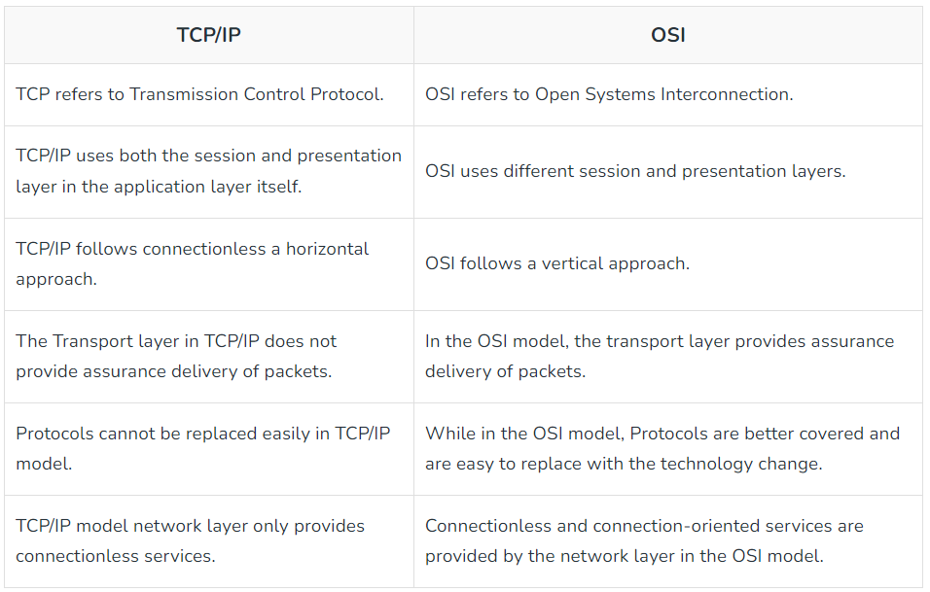
2.2 TCP/IP NETWORK MODEL
Other Common Internet Protocols: TCP/IP Model covers many Internet Protocols. The main rule of these Internet Protocols is how the data is validated and sent over the Internet. Some Common Internet Protocols include:
HTTP (Hypertext Transfer Protocol): HTTP takes care of Web Browsers and Websites.
FTP (File Transfer Protocol): FTP takes care of how the file is to be sent over the Internet.
SMTP (Simple Mail Transfer Protocol): SMTP is used to send and receive data.
Difference between TCP/IP and OSI Model

Slide 82
Assessments
Here are some assessments you can use to evaluate your understanding of protocols, interfaces, and network reference models like ISO OSI and TCP/IP:
Protocol Matching:
Provide a list of network protocols and a corresponding list of descriptions or functionalities.
Ask learners to match each protocol with its correct description or functionality.
Example protocols: a) HTTP b) FTP c) DNS d) TCP
Example descriptions:
A protocol used for transferring files between a client and a server.
A protocol used for resolving domain names to IP addresses.
A protocol used for accessing websites and transferring hypertext data.
A reliable, connection-oriented protocol that guarantees delivery of data.
Interface Evaluation:
Present screenshots or mock-ups of different network interfaces, such as router configuration interfaces or network monitoring tools.
Ask learners to evaluate the interfaces based on usability, intuitiveness, and functionality.
Request them to provide suggestions for improvement or identify potential issues with the interfaces.
Reference Model Comparison:
Create a comparison chart or table that includes the ISO OSI model and the TCP/IP model.
List the layers of each model and their associated protocols or functions.
Ask learners to identify similarities and differences between the models and explain the advantages of each.
Protocol Troubleshooting Scenario:
Present a scenario involving a network issue related to a specific protocol, such as an HTTP server returning error codes or DNS resolution problems.
Ask learners to analyze the scenario, identify the potential causes, and propose steps to troubleshoot and resolve the issue.
Protocol Analysis Questions:
Prepare a set of questions that require learners to analyze and explain the behavior, features, or use cases of various protocols.
Include questions about TCP/IP, DNS, DHCP, HTTP, and other relevant protocols.
Evaluate their understanding of how these protocols function and their roles in network communication.
Example question: How does the TCP protocol ensure reliable data delivery in a network?
Network Reference Model Quiz:
Create a quiz consisting of multiple-choice or true/false questions that assess learners' knowledge of the ISO OSI and TCP/IP models.
Include questions about the layers, protocols, and functionalities of each model.
Provide immediate feedback to learners regarding their answers.
These assessments will help you gauge your understanding of protocols, interfaces, and network reference models like ISO OSI and TCP/IP. Adapt the questions and scenarios to suit the level of expertise and learning objectives.

Slide 83
Activities
Here are some activities to help you understand protocols, interfaces, and network reference models like the ISO OSI model and TCP/IP:
Protocol Comparison:
Choose two network protocols, such as HTTP and FTP, and compare their features, purposes, and use cases.
Create a presentation or infographic highlighting the similarities and differences between the protocols, including their advantages and disadvantages.
Interface Design:
Select a network interface, such as a web-based user interface for a router or a network monitoring tool.
Design a user-friendly interface that allows users to configure network settings, monitor traffic, or troubleshoot network issues.
Create wireframes or prototypes to illustrate the interface design and explain its functionality.
ISO OSI Model Exploration:
Research the ISO OSI model and its seven layers: Physical, Data Link, Network, Transport, Session, Presentation, and Application.
Create a visual representation of the model, including each layer and its associated protocols or functions.
Explain the purpose and responsibilities of each layer and provide examples of protocols or technologies used at each layer.
TCP/IP Model Analysis:
Investigate the TCP/IP model, which is a simplified four-layer model consisting of the Network Interface, Internet, Transport, and Application layers.
Compare and contrast the TCP/IP model with the ISO OSI model, focusing on the similarities and differences in their layer structures.
Discuss the advantages of the TCP/IP model, which is widely used in modern networks.
Protocol Troubleshooting:
Select a network protocol, such as DHCP or DNS, and research common issues or errors that can occur.
Simulate or find examples of protocol-related problems, such as DHCP lease failures or DNS resolution errors.
Analyze the issues, identify potential causes, and propose troubleshooting steps to resolve the problems.
Network Reference Model Quiz:
Create a quiz or interactive activity to test knowledge of network reference models like ISO OSI and TCP/IP.
Include questions that cover the layers, protocols, and functionalities of these models.
Provide feedback and explanations for correct and incorrect answers to reinforce understanding.
Protocol Simulation:
Use network simulation software like Cisco Packet Tracer or GNS3 to create a virtual network environment.
Configure devices and simulate network traffic using specific protocols, such as TCP, UDP, or ICMP.
Observe and analyze the behavior of the protocols in action, including packet exchange, error handling, and flow control.
Network Protocol Research Paper:
Choose a specific network protocol, such as IPv6 or SSL/TLS, and conduct in-depth research on its features, evolution, and significance.
Write a research paper or create a presentation summarizing the findings, including the protocol's advantages, adoption challenges, and future prospects.
These activities will enhance your understanding of protocols, interfaces, and network reference models like the ISO OSI model and TCP/IP. They provide opportunities for hands-on exploration, analysis, and application of the concepts.

Slide 84
Did You Know?
Did you know? The ISO OSI (Open Systems Interconnection) model is a conceptual framework that standardizes the functions of a network into seven layers: Physical, Data Link, Network, Transport, Session, Presentation, and Application.
True statement: The TCP/IP (Transmission Control Protocol/Internet Protocol) suite is the foundational protocol suite for the Internet and modern networking. It consists of four layers: Network Interface, Internet, Transport, and Application.
Did you know? HTTP (Hypertext Transfer Protocol) is the primary protocol used for transmitting data over the World Wide Web. It operates at the Application layer of the TCP/IP model.
True statement: SMTP (Simple Mail Transfer Protocol) is a protocol used for sending and receiving email messages. It operates at the Application layer of the TCP/IP model.
Did you know? FTP (File Transfer Protocol) is a protocol used for transferring files between a client and a server. It operates at the Application layer of the TCP/IP model.
True statement: An interface in networking refers to the point of interaction between two systems or components, enabling them to exchange information or perform actions. It can be a physical connector, a software component, or a combination of both.
Did you know? Network reference models, such as the ISO OSI model and the TCP/IP model, provide a structured approach to understanding and designing network architectures.
True statement: Layered architecture is a design approach that breaks down complex systems into layers, where each layer performs specific functions and interacts with adjacent layers. The ISO OSI and TCP/IP models are examples of layered architectures.
Did you know? The ISO OSI model and the TCP/IP model have similarities but differ in terms of the number of layers and the specific protocols associated with each layer.
True statement: Layered architectures like the ISO OSI model and the TCP/IP model allow for modular design, interoperability, and easier troubleshooting in network systems.
Did you know? Layered architectures provide a common language and framework for network engineers and developers to understand and discuss network operations, troubleshooting, and protocol interactions.
True statement: The ISO OSI model and the TCP/IP model are both conceptual models that help in understanding and implementing network protocols, but the TCP/IP model is more widely used in modern networks, particularly the Internet.
These facts and statements provide insights into protocols, interfaces, network reference models such as ISO OSI and TCP/IP, and the benefits of layered architecture. They highlight the significance of these concepts in understanding and designing modern computer networks.

Slide 85
3. ARPANET and INTERNET
ARPANET (Advanced Research Projects Agency Network) was the precursor to the modern-day Internet. It was a pioneering computer network developed by the United States Department of Defense's Advanced Research Projects Agency (ARPA) in the late 1960s. ARPANET was designed to connect computers and researchers at various universities and research institutions to facilitate communication and collaboration.
Development and Purpose: ARPANET was developed in response to the need for a robust and reliable network that could withstand partial failures or attacks. Its primary purpose was to facilitate communication and resource sharing among researchers working on defense-related projects.
Packet Switching Technology: ARPANET utilized packet switching, a revolutionary approach that divided data into small packets for efficient transmission. This technology allowed for the efficient use of network resources and enabled data to be routed dynamically across different paths.
Network Topology: ARPANET initially adopted a decentralized network architecture known as a "distributed network," allowing multiple nodes to connect with each other directly. Later, ARPANET transitioned to a more structured and scalable network architecture based on the concept of routers and gateway computers.
Host-to-Host Communication: ARPANET enabled host-to-host communication, allowing computers connected to the network to exchange data and messages. Each computer on the network had a unique network address, and data packets were addressed and routed based on these addresses.
Protocols and Standards: ARPANET introduced several key protocols, including the Network Control Program (NCP) and the Interface Message Processor (IMP) protocol. These protocols laid the foundation for subsequent network protocols, such as TCP/IP (Transmission Control Protocol/Internet Protocol).
Expansion and Legacy: ARPANET expanded rapidly throughout the 1970s, connecting more universities, research institutions, and government agencies. The success of ARPANET paved the way for the development of the modern Internet, as it demonstrated the feasibility and benefits of interconnected computer networks.

Slide 86
3. ARPANET and INTERNET
The Internet is a global network of interconnected computer networks that enables communication, information sharing, and access to various services. It is the result of decades of development and evolution from the initial ARPANET project.
Worldwide Network: The Internet spans the entire globe, connecting millions of computers and devices across different continents and countries. It provides a universal platform for communication, collaboration, and access to a vast amount of information.
TCP/IP Protocol Suite: The Internet relies on the TCP/IP protocol suite, which consists of the Transmission Control Protocol (TCP) and the Internet Protocol (IP). TCP/IP provides a standardized set of rules and procedures for data transmission, addressing, routing, and error handling on the Internet.
Client-Server Model: The Internet follows a client-server model, where client devices (such as computers, smartphones, and tablets) request services or information from server devices (such as web servers, email servers, and file servers). This model allows users to access various services, including websites, email, file sharing, video streaming, and online gaming.
World Wide Web (WWW): The World Wide Web, commonly known as the web, is a system of interconnected hypertext documents and resources accessible through the Internet. The web relies on technologies such as Hypertext Transfer Protocol (HTTP) and Hypertext Markup Language (HTML) to navigate and display web pages.
Internet Service Providers (ISPs): Internet Service Providers are companies or organizations that provide users with access to the Internet. ISPs offer various types of connections, such as dial-up, broadband (DSL or cable), and wireless, allowing users to connect their devices to the Internet.
Global Impact: The Internet has had a profound impact on society, transforming various aspects of communication, commerce, education, entertainment, and social interactions. It has revolutionized industries, created new business models, and empowered individuals with instant access to information and global connectivity.

Slide 87
4. PHYSICAL LAYER
The Physical Layer is the first and lowest layer in the OSI (Open Systems Interconnection) model or the TCP/IP model. It is responsible for transmitting raw bitstream data over the physical medium, ensuring reliable and efficient communication between network devices. The Physical Layer defines the electrical, mechanical, procedural, and functional specifications for the physical transmission of data.
Functions of the Physical Layer: a. Bit Representation: The Physical Layer converts data bits into electrical, optical, or wireless signals suitable for transmission. b. Data Encoding: It determines how the data is encoded into physical signals for transmission and decoding at the receiving end. c. Physical Signaling: The Physical Layer defines the characteristics of voltage levels, waveforms, modulation, and frequency for signal transmission. d. Transmission Medium: It specifies the type of physical medium used for data transmission, such as guided or unguided media. e. Medium Access Control: In some cases, the Physical Layer is responsible for managing access to the transmission medium, such as in Ethernet networks.
4.1 Guided Transmission Media: Guided transmission media refers to physical media that provide a path or guide for transmitting signals. It includes twisted pairs, coaxial cables, and fiber optics.
4.1.1 Twisted Pair: Twisted pair cables consist of pairs of insulated copper wires twisted together to reduce interference from external sources. They are commonly used in Ethernet networks for short to medium-distance communication. Twisted pairs are categorized into various classes, such as Cat5e, Cat6, and Cat7, offering different levels of performance and data rates.
4.1.2 Coaxial Cable: Coaxial cables consist of a central conductor, surrounded by an insulating layer, a metallic shield, and an outer insulating jacket. They are widely used in cable television (CATV) systems and broadband Internet connections. Coaxial cables provide better shielding against electromagnetic interference (EMI) compared to twisted pairs and offer higher bandwidth and longer transmission distances.
4.1.3 Fiber Optics: Fiber optic cables transmit data using light signals instead of electrical signals. They consist of a core, which carries the light signals, surrounded by a cladding layer and an outer protective jacket. Fiber optics offer high bandwidth, low attenuation, and immunity to EMI, making them ideal for long-distance and high-speed data transmission. They are commonly used in telecommunications, internet backbones, and high-speed networking applications.

Slide 88
4. PHYSICAL LAYER
4.2 Wireless transmission refers to the transmission of data through the air or free space using radio frequency signals or electromagnetic waves.
4.2.1 Wireless Communication Technologies:
Wi-Fi (Wireless Fidelity): Wi-Fi is a wireless networking technology that allows devices to connect to a local area network (LAN) or the internet without the need for physical cables. It operates in the unlicensed radio frequency spectrum.
Bluetooth: Bluetooth enables short-range wireless communication between devices, typically within a range of a few meters. It is commonly used for connecting peripherals like keyboards, mice, and speakers to computers and smartphones.
Cellular Networks: Cellular networks provide wireless communication over large geographic areas using a network of base stations. They enable voice and data communication for mobile phones and other cellular-enabled devices.
Satellite Communication: Satellite communication uses orbiting satellites to transmit signals over long distances. It is used for various applications, including television broadcasting, global positioning systems (GPS), and long-distance communication in remote areas.
4.2.2 Advantages of Wireless Transmission:
Mobility: Wireless transmission allows devices to communicate without physical constraints, providing mobility and flexibility.
Easy Deployment: Wireless networks can be set up quickly without the need for extensive cabling infrastructure.
Scalability: Wireless networks can easily accommodate additional devices without significant physical modifications.
4.2.3 Challenges of Wireless Transmission:
Interference: Wireless signals are susceptible to interference from other devices, obstacles, or environmental factors.
Limited Range: Wireless signals have limited range compared to guided transmission media, requiring the presence of access points or repeaters for extended coverage.
Security: Wireless networks are more vulnerable to unauthorized access and data breaches, requiring robust security measures such as encryption and authentication.

Slide 89
Assessments
Here are some assessments you can use to evaluate understanding of ARPANet, the Internet, physical layer, guided media, unguided media, and wireless transmission:
ARPANet Quiz:
Create a quiz consisting of multiple-choice or true/false questions about ARPANet and its significance.
Include questions about the initial connections, key contributors, and the evolution of ARPANet into the modern Internet.
Evaluate learners' knowledge of the historical development and impact of ARPANet.
Internet Protocol Identification:
Provide a list of IP addresses or domain names and ask learners to identify the corresponding protocols or services associated with them.
For example, learners might need to match an IP address with the HTTP protocol or a domain name with the DNS service.
Assess their understanding of how protocols operate at the Internet layer and their familiarity with common Internet services.
Physical Layer Troubleshooting:
Present learners with scenarios involving physical layer issues, such as faulty cables, loose connections, or damaged network devices.
Ask them to diagnose the problems and propose steps to troubleshoot and resolve the issues.
Evaluate their ability to apply knowledge of the physical layer and its impact on network connectivity.
Guided vs. Unguided Media Comparison:
Provide a list of characteristics, advantages, and disadvantages of guided media (e.g., fiber optic cables, twisted pair cables) and unguided media (e.g., wireless signals, radio waves).
Ask learners to match the characteristics with the appropriate media type.
Evaluate their understanding of the differences between guided and unguided media and their ability to assess their suitability for specific scenarios.
Wireless Transmission Case Study:
Present learners with a real-world case study that involves wireless transmission technologies, such as Wi-Fi or cellular networks.
Ask them to analyze the scenario, identify the wireless transmission challenges, and propose solutions or recommendations to overcome the challenges.
Evaluate their understanding of wireless transmission technologies and their ability to apply them in practical scenarios.
Internet Connectivity Survey:
Design a survey that assesses learners' knowledge of different factors influencing Internet connectivity, such as network infrastructure, service providers, and technology.
Include questions about broadband types, mobile networks, and challenges in providing universal Internet access.
Assess their comprehension of the factors affecting Internet connectivity and their ability to analyze the complexities involved.
Internet Terminology Matching:
Provide a list of Internet-related terms and a corresponding list of definitions or descriptions.
Ask learners to match each term with its correct definition or description.
Evaluate their understanding of Internet-specific terminology, including concepts related to ARPANet, protocols, physical layer, and media types.
These assessments will help evaluate learners' understanding of ARPANet, the Internet, physical layer, guided media, unguided media, and wireless transmission. Adapt the questions and scenarios to suit the level of expertise and learning objectives.

Slide 90
Activities
Here are some activities related to ARPANet, the Internet, physical layer, guided media, unguided media, and wireless transmission:
ARPANet Timeline:
Create a timeline of key events in the history of ARPANet, the precursor to the modern Internet.
Include significant milestones such as the initial connection between UCLA and Stanford, the development of TCP/IP, and the transition to the Internet we know today.
Add brief descriptions or images to highlight the importance of each event.
Internet Service Provider Comparison:
Research and compare different Internet Service Providers (ISPs) in terms of their offerings, coverage, speeds, and pricing.
Create a table or infographic that presents the information in a visually appealing manner.
Ask learners to analyze and discuss the factors to consider when selecting an ISP and which provider would be most suitable for different scenarios.
Physical Layer Experiment:
Set up a hands-on activity to demonstrate the physical layer of a network.
Provide materials such as Ethernet cables, connectors, and network devices like switches or routers.
Ask learners to create a small network by properly connecting devices using the cables and connectors.
Discuss the significance of the physical layer in transmitting data and ensuring reliable communication.
Guided Media vs. Unguided Media Debate:
Divide learners into two groups and assign one group to guided media (e.g., copper cables, fiber optic cables) and the other to unguided media (e.g., wireless signals).
Have each group research and prepare arguments highlighting the advantages and disadvantages of their assigned media type.
Conduct a debate or panel discussion where each group presents their findings and responds to counterarguments.
Encourage critical thinking and exploration of the applications and limitations of each type of media.
Wireless Transmission Scavenger Hunt:
Organize a scavenger hunt where learners explore different wireless transmission technologies in their surroundings.
Provide a list of wireless devices and technologies such as Wi-Fi, Bluetooth, NFC, or cellular networks.
Ask learners to find examples of these technologies in their environment and explain how they are used for wireless communication.
Encourage discussions on the benefits, limitations, and potential security concerns associated with wireless transmission.
ARPANet and Internet Evolution Presentation:
Assign learners to research and create presentations on the evolution of ARPANet and its transformation into the Internet.
Include key milestones, technologies, and notable contributors in their presentations.
Ask learners to present their findings to the class, highlighting the impact of ARPANet and the growth and significance of the Internet in today's world.
Internet Connectivity Challenges:
Present learners with various scenarios where individuals or communities face challenges in accessing reliable Internet connectivity.
Examples could include remote areas, developing countries, or areas affected by natural disasters.
Ask learners to brainstorm and propose creative solutions or technologies that could help address these challenges and provide connectivity to underserved areas.
These activities provide opportunities to explore and deepen understanding of ARPANet, the Internet, physical layer, guided media, unguided media, and wireless transmission. They encourage research, critical thinking, and hands-on experiences to enhance knowledge and engagement with these concepts.

Slide 91
Did You Know?
Did you know? ARPANet, created by the U.S. Department of Defense's Advanced Research Projects Agency (ARPA), was the first operational packet-switched network and served as the foundation for the modern Internet.
Did you know? The Internet is a global network of interconnected computers and devices that allows for the exchange of information and communication across the world.
Did you know? The physical layer of a network refers to the lowest layer in the OSI model and is responsible for the transmission of raw, unstructured data over physical mediums such as copper or fiber optic cables.
Did you know? Guided media, also known as wired media, are physical mediums that provide a direct path for signals to travel. Examples include copper cables (such as twisted pair or coaxial cables) and fiber optic cables.
Did you know? Unguided media, also known as wireless media, are communication channels that transmit signals without the need for physical cables. Examples include radio waves, microwaves, and infrared.
Did you know? Wireless transmission refers to the transfer of data or information over the air using wireless technologies such as Wi-Fi, Bluetooth, cellular networks, and satellite communications.
Did you know? The development of wireless transmission technologies has greatly contributed to the proliferation of mobile devices, enabling seamless communication and access to the Internet from virtually anywhere.
Did you know? The physical layer is responsible for converting digital data into analog signals for transmission and then converting received analog signals back into digital data for the receiving device to interpret.
Did you know? Guided media, such as fiber optic cables, offer advantages like high data transmission speeds, resistance to electromagnetic interference, and longer distances without signal degradation compared to some other media types.
Did you know? Wireless transmission technologies allow for flexible connectivity and mobility, making them particularly useful in scenarios where wired connections are not practical or feasible, such as in remote areas or for mobile devices.
Did you know? The Internet relies on a complex global network infrastructure, including undersea cables, terrestrial networks, routers, and data centers, to facilitate the exchange of data across vast distances.
Did you know? The physical layer, guided media, unguided media, and wireless transmission technologies are all fundamental components that enable the functioning of modern networks and the Internet.

Slide 92

Summary
Outcomes:
Comprehend the fundamental concepts of networks in the advanced computer networks
Identify the importance of the types of networks in their respective application
Deploy the right network architecture according to the type and requirements
Implement the right topology for the required network connectivity

Slide 93
Terminal Questions

Slide 94
Reference Links
Reference Material
Computer Networks -- Andrew S Tanenbaum, David. j. Wetherall, 5th Edition. Pearson Education/PHI
An Engineering Approach to Computer Networks-S. Keshav, 2nd Edition, Pearson Education
Data Communications and Networking – Behrouz A. Forouzan. Third Edition TMH.
Behrouz A. Forouzan (2006), Data communication and Networking, 4th Edition, Mc Graw Hill, India.
Kurose, Ross (2010), Computer Networking: A top-down approach, Pearson Education, India Put your link here.

Slide 95
Thank you

